Slide 1
Working Together to Safeguard Children
Level 1
2026-2027 Academic Year

Slide 2
What’s New This Year (2026–2027)
Safeguarding 2026: Key Headlines
Earlier Help, Better Outcomes
Family Help and prevention are at the heart of safeguarding.
Stronger Multi-Agency Working
Shared responsibility and collaborative decision-making.
Information Sharing Matters
Timely information sharing supports effective safeguarding.
Education's Vital Safeguarding Role
Schools are central to identifying concerns and coordinating support.
Attendance is Safeguarding
Absence may be an indicator of vulnerability, abuse or exploitation.
Record Every Concern
Low-level concerns may reveal emerging patterns of risk.
A Strong Safeguarding Culture
Professional curiosity and the "it could happen here" approach remain essential.
Emerging Risks in a Digital World
AI, deepfakes, online exploitation and technology-facilitated abuse.

Slide 3
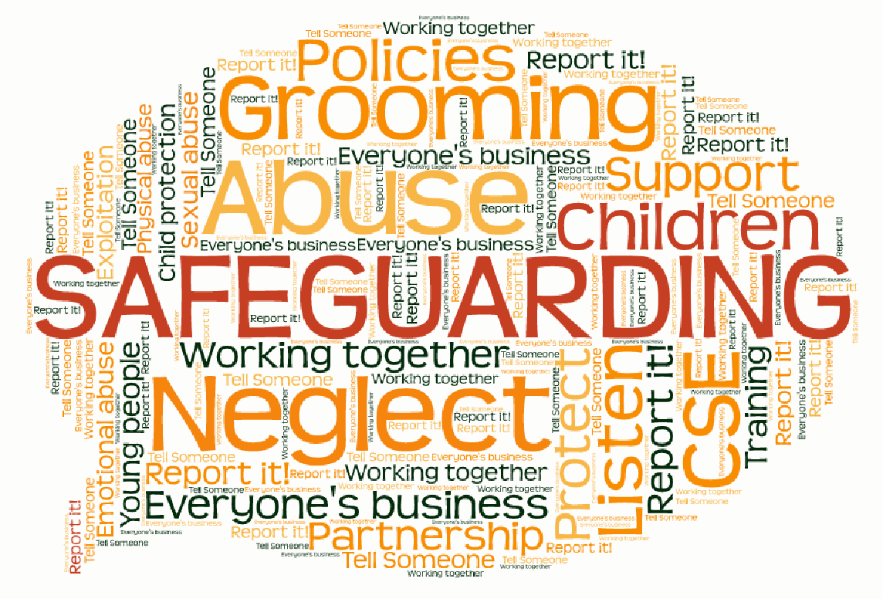
Learning Outcomes:
Provide an overview of different types of abuse and neglect
Think about signs & indicators to look out for
Explore good practice in responding to concerns
There may be some information shared, or topics discussed, that cause you to feel uncomfortable, feel free to take a break if you need to.
Notes:
Please be mindful of confidentiality when discussing any case examples.
This is a focus on good practice thinking about us as professionals – it may affect you personally so please seek support after from………..

Slide 4
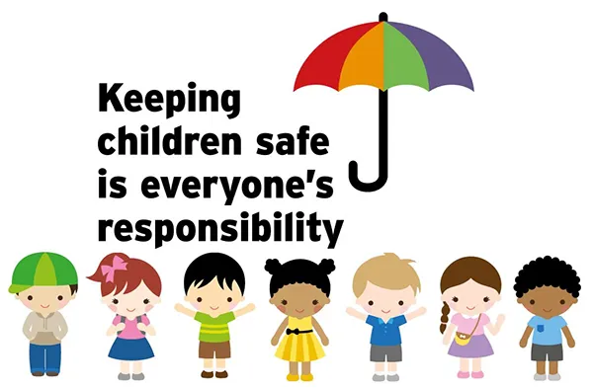
Safeguarding and promoting the welfare of children includes:
Taking action to enable all children to have the best outcomes
Preventing impairment to children’s mental and physical health or development
Ensuring children are growing up in circumstances consistent with safe and effective care
Protecting children from maltreatment
Notes:
Children have a right to be safe and should be protected from all forms of abuse and neglect;
• safeguarding children is everyone’s responsibility;
• it is better to help children as early as possible, before issues escalate and become more damaging and we have a duty to do everything we can to prevent harm coming to children; and
• children and families are best supported and protected when there is a co-ordinated response from all relevant agencies.
All school staff should also be aware that mental health problems can, in some cases, be an indicator that a child has suffered or is at risk of suffering abuse, neglect or exploitation.

Slide 5
Key Safeguarding Guidance (2026)
KCSIE 2026 – statutory guidance for education
Working Together 2026 – national multi-agency framework
Stronger focus on:
  Joint working
  Shared accountability
  Child-centred practice
All staff must understand safeguarding responsibilities

Slide 6
Working Together 2026 – Key Messages
Working Together 2026 is about earlier help, stronger multi-agency collaboration, effective information sharing, anti-discriminatory practice, and keeping the child's lived experience at the heart of every safeguarding decision. [
What this means for schools
Think Family Help, not just referrals.
Share information earlier.
Remain professionally curious.
Consider attendance, behaviour and wellbeing as safeguarding indicators.
Understand online, contextual and extra-familial harms.
Ensure every action is guided by the question:"What is life like for this child?"

Slide 7
Working Together 2026 – Key Messages
Family Help is the new integrated model within Working Together to Safeguard Children 2026. It brings together what was traditionally known as Early Help and Section 17 Child in Need support, creating a more coordinated and seamless service for children and families
Key Principles of Family Help
Child-centred: focused on the child's lived experience.
Whole-family approach: works with parents, carers and wider family networks.
Multi-agency: professionals work together around one plan.
Strengths-based: identifies what is working well as well as areas of concern.
Early intervention: support is provided before risks escalate.
Think "Family Help sooner".
Don't wait for problems to become safeguarding crises. Family Help is designed to provide coordinated support at the earliest opportunity while keeping the child and family at the centre of planning.

Slide 8
Working Together 2026 – Key Messages
The Purpose of Family Help
Family Help aims to:
Identify needs and concerns earlier.
Provide support before problems escalate into child protection concerns.
Reduce the need for repeated referrals between services.
Ensure families receive coordinated support from the right professionals at the right time.
Improve outcomes by building on family strengths and protective factors.
What Does This Mean for Schools?
Schools are often the first agency to notice when a child or family may need support.
DSLs and school staff should:
Identify emerging concerns early.
Engage families at the earliest opportunity.
Work collaboratively with Family Help practitioners.
Share relevant information promptly.
Contribute to Family Help assessments, plans and review meetings.
Continue monitoring the child's experience and outcomes while support is in place.

Slide 9
Key themes in KCSIE 2026
Stronger safeguarding culture
"It could happen here" remains the foundation of safeguarding practice.
All staff must remain professionally curious, vigilant and prepared to act on concerns.
Every member of staff is now expected to understand and engage with safeguarding responsibilities, recognising that safeguarding is everyone's responsibility.
Attendance is Safeguarding
Being absent from education, as well as missing education, can be an indicator of abuse, neglect, exploitation or other safeguarding concerns.
Attendance concerns should always be considered within a safeguarding context.
Early identification and intervention are essential.
Low-Level Concerns
All concerns, however small, should be recorded, shared and reviewed.
Patterns of behaviour over time may indicate emerging safeguarding risks.
Creating a culture of reporting helps protect both children and staff.
Notes:
These are still draft as actual guidance is not out yet- make sure updates are made when new guidance is out in September
Safeguarding culture- it could happen here- challenge assumptions, remain vigilant focus on whole- school culture and staff attitudes and response
Attendance- -' Absence is a key indicator of risk, not just non- compliance'
Low level concerns- emphasis on professional curiosity
DSL role expansion- DSL to have oversight of whole- school safeguarding systems including online safeguarding culture
Explicit inclusion of Deepfakes, AI generated images

Slide 10
Online Safety and Emerging Risks
KCSIE 2026 places increased emphasis on:
AI-generated abuse, deepfakes and nudification apps.
Online coercion, grooming and exploitation.
Self-generated intimate images, including AI-generated content.
Misinformation, disinformation and harmful online influences.
Technology-facilitated abuse and harmful digital behaviours.
Child-on-Child Abuse
Greater focus on prevention and early intervention.
Harmful sexual behaviour must never be dismissed as "banter" or part of growing up.
Recognition of misogyny as a potential driver of harmful behaviour.
Notes:
Explicit inclusion of Deepfakes, AI generated images
DSL role expansion- DSL to have oversight of whole- school safeguarding systems including online safeguarding culture
Explicit inclusion of Deepfakes, AI generated images

Slide 11
The Role of the DSL
Strengthened DSL Oversight
The DSL should provide leadership and oversight of:
Whole-school safeguarding culture.
Online safety arrangements.
Filtering and monitoring systems.
Early Help and Family Help pathways.
Information sharing and multi-agency working.
Staff training and safeguarding awareness.
Early Help, Family Help and Multi-Agency Working
Family Help and Early Intervention
KCSIE 2026 aligns with Working Together reforms and the Family Help model.
Schools play a vital role in identifying emerging needs early.
Early support can prevent concerns escalating to statutory intervention.
DSLs should understand local Family Help pathways and referral processes.
Multi-Agency Working
Stronger expectations around:
Timely decision-making.
Professional challenge where required.
Effective information sharing.
Early Help and Family Help engagement.
Recognition of education as a key safeguarding partner
Notes:
Explicit inclusion of Deepfakes, AI generated images
DSL role expansion- DSL to have oversight of whole- school safeguarding systems including online safeguarding culture
Explicit inclusion of Deepfakes, AI generated images

Slide 12
Additional KCSIE 2026 Focus Areas
Gender-Questioning Children
Schools should be aware of:
Individual safeguarding risk assessments.
Working with parents and carers where appropriate.
Safeguarding considerations relating to social transition and school practice.
Decisions being based on the child's welfare and best interests.
Key Message for Staff
Safeguarding in 2026 is increasingly focused on early intervention, emerging online harms, child-on-child abuse prevention, Family Help, and maintaining a strong safeguarding culture where every adult plays an active role in keeping children safe
Notes:
Explicit inclusion of Deepfakes, AI generated images
DSL role expansion- DSL to have oversight of whole- school safeguarding systems including online safeguarding culture
Explicit inclusion of Deepfakes, AI generated images

Slide 13
Implications for Staff
Safeguarding is everyone’s responsibility
All staff to read Part 1 of KCSIE
Act immediately – do not delay
Record all concerns, including low-level
Share information with DSL
Be professionally curious
Always focus on the child’s lived experience
"Safeguarding practice must reflect current risks, not just statutory minimum requirements.”

Slide 14
RSHE 2026 – Key Updates for Schools
RSHE is a safeguarding tool
Supports children to recognise abuse, exploitation and unhealthy relationships
Helps pupils know how and where to seek help
Increased focus on online harms
Teaching must now include:
  Pornography and its impact- must be addressed in Secondary but in Primary schools focus on Body safety, healthy relationships, online safety, understanding inappropriate content
  Deepfakes and AI-generated images
  Sextortion, coercion and online scams
  Harmful content and online behaviours
Notes:
Relationship Sex Health Education (RSHE) has become a really important part of safeguarding — it’s not just a curriculum subject anymore, it’s a key way we help children recognise risk and stay safe.”
One of the biggest changes is the focus on online harm.
Children are now exposed to risks like pornography, coercion, and manipulation at much younger ages.” DO NOT TEACH ABOUT PORNOGRAPHY IN PRIMARY –
“You’ll also see increasing references to things like deepfakes and AI-generated images — these are becoming real safeguarding issues in schools.”
Talk Pants – younger children.

Slide 15
AI and emerging risks
Pupils need to understand:
  How technology can be used to manipulate and harm
  Risks of sharing images and content online
  Safeguarding during RSHE lessons
Discussions may lead to increased disclosures
Staff must:
  Know how to respond appropriately
  Understand confidentiality limits
  Follow safeguarding procedures without delay
Parental transparency
Schools must make RSHE materials available to parents
Clear communication about:
  what is being taught
  when it is being taught
Notes:
A key point to remember — RSHE lessons can lead to disclosures.”
“When we talk about relationships, consent, or online safety, children may:
Recognise something isn’t right
Or feel safe enough to tell someone”
“So it’s really important that:
You know how to respond
You stay calm
And you follow safeguarding procedures straight away”

Slide 16
External providers
Schools must:
  Check credentials and content
  Ensure safeguarding procedures are in place
  Monitor quality and appropriateness
Notes:
🔹 External providers
“If external organisations come in to deliver sessions, schools now have a responsibility to:
Check what is being taught
Ensure it’s appropriate
And make sure safeguarding processes are clear”
RSHE isn’t just about education — it’s about giving children the knowledge and confidence to stay safe, and making sure we’re ready to act when they tell us something.”

Slide 17
External Clubs on School Sites – Safeguarding Duties
The school retains safeguarding responsibility for its premises at all times, regardless of when the site is used.
•Schools retain safeguarding responsibility when third parties use their premises.
•Follow Keeping Children Safe in Education requirements
•Verify DBS checks for adults working with children
•Check safeguarding/child protection policy is in place
•Confirm provider has a designated safeguarding lead
•Ensure safe recruitment and supervision ratios
Notes:
The school retains safeguarding responsibility for its premises at all times, regardless of when the site is used.

Slide 18
•Carry out risk assessments (safeguarding + H&S)
•Agree clear reporting procedures for concerns
•Use formal lettings agreements with safeguarding clauses
•Check insurance, qualifications and compliance
•Undertake monitoring and respond to concerns promptly
For weekends especially, schools should:
Have a clear lettings policy approved by governors
Ensure written agreements explicitly cover safeguarding
Confirm:
  Who is in charge on site
  Who manages incidents or disclosures
Provide clear contact/escalation procedures
Consider periodic spot checks or monitoring
Notes:
“Safeguarding responsibility doesn’t stop at 3pm on a Friday — if it’s happening on your site, you are still responsible for ensuring it’s safe.”

Slide 19
Child Protection Policy
Behaviour Policy
Code of Conduct
Children Missing Education (CME)
Part One
KCSIE 2026
Role of the DSL
Notes:
As a minimum all staff need to be familiar with these policies, guidance and roles of key staff. You need to ensure that you revisit this at least annually, and whenever any key changes are made. Your DSL will communicate this to you.
Know your safeguarding policy and where to access it –
You need to be aware of the signs and indicators of abuse and your statuary obligations and duties
What would you do if there was a safeguarding concern tomorrow? Where would you record it? How would you record it? Who is your designated safeguarding lead? What if they’re not available?
Discuss concerns with your Designated Safeguarding Lead and **Be prompt and avoid delay – Don’t wait for the end of the day**
It is important to be aware of and follow the behaviour policy clearly. The aim is for all children and YP to be aware what is and what isn’t acceptable behaviour. This can help prevent behaviours of concern escalating and any unhealthy cultures being created in the school or children being placed at further risk. When implementing the behaviour policy we also need to be thinking is any safeguarding response needed? What might be the reasons for this child/YP’s behaviour, might something be happening to them?
Do you know the staff code of conduct? For example, when you may or may not be able to have physical contact with a child. It is your responsibility to know this and saying you weren’t aware after an event is not an excuse. This also includes the staff AUP (Acceptable Use policy) – do you know the rules around posting on social media/using your phone in school?
Schools should have a policy on Children Missing Education. This is often an important indicator of concern about possible abuse/exploitation a child/young person may be experiencing.
Do you know the role of the DSL?
This include collating all information on a child/young person – this may include information you are not aware of
They hold specialist safeguarding knowledge so are there to guide and support you where a concern about a child/YP may become apparent.

Slide 20

Statements about child abuse:
Children are more likely to be sexually abused by someone they don’t know
Children from wealthy backgrounds won’t experience neglect
Injuries on the face and neck are common for children who are mobile
Most perpetrators of sexual abuse are old men
Children with disabilities are more likely to experience abuse than other children
A high percentage of children make false disclosures of sexual abuse, for attention seeking purposes
Online abuse is less harmful to victims than face to face abuse.
Teachers have a legal duty to report a disclosure of Female Genital Mutilation to the police
If children don’t directly witness domestic abuse, it is less harmful to them than if they witness it
The definition of child sexual abuse does not include 16/17-year-olds because they can legally consent to
having sex.
11. Children who have suffered abuse or neglect are more likely to be at risk of exploitation
12. Children abused by parents or carers are almost 3 times more likely to also witness family violence
Upskirting is something boys do when they are playing around -it causes no harm
14. 1 in 10 children sexually abused by an adult didn’t tell anyone at the time
Notes:
Introduce myth busting exercise – can choose do this or not as it is mostly the same as last year but always relevant for some new staff – added 3 new questions at the end.
10:15 – 10:45 – 10 mins discuss in pairs
20 mins discussion
False- - only 10% of sexually abused children are abused by a stranger. The other 90% of survivors are abused by someone they (or their family) know and trust. Perpetrators integrate themselves into everyone’s life, not just the child’s. They build relationships with the caregivers, family and friends so that they are trusted to be alone with the child. Gaining access this way gives them many more opportunities to perpetrate.
False – Often we over look neglect in children from wealthy families. On the surface the signs may be less obvious and parents who are articulate/professional can sometimes be harder to challenge when there are concerns. We will explore this further in the session but remember neglect includes failure to provide adequate supervision, failure to safeguard children from other unsafe adults/scenarios and failure to provide the appropriate emotional support and stimulation to a child. Think about children & young people whose parents may not be very present in their lives, what impact is this having?
False - Injuries on the face and neck would not be considered common for mobile children. Be curious – ask where these have come from, does that seem right? It is rare to be injured on the neck and face in accidental play.
4. False- old men- men and women can be perpetrators of sexual abuse, and can be of any age. In our line of work we see a number of people of concern in early 20’s.
Research has found women account for 5-10% of all sexual abuse against children (Bunting, 2005. Freel, 1998. Cortoni, 2010.). May want to illustrate this point with the recent high profile court case of Ghislaine Maxwell. Instrumental to exploiting and grooming children to then be further sexually abused by Epstein.
Children can also abuse other children. We must still take this seriously, the impact is likely to still be as significant for the victim. We also need to consider the abusing child – have they been abused? What could be the reasons for the behaviour? What support might they need?
5. True- Disabilities – children with disabilities are over 3 times more likely to be abused than non-disabled children
6. False- allegations (attention seeking)- Statistics show that only 4-8% of reports of abuse made by children are false or fabricated. Or, in other words, between 92 and 96% of reports are true. That’s a lot! If a child is willing to come forward, it’s rare that they’re lying. “Disclosure,” the term for telling someone about your experience of abuse, is never easy for survivors.
7. False – Online sexual abuse can be just as harmful to victims. Sometimes victims feel they can’t escape as online world is always there. Online abuse can also go on to facilitate real word abuse.
8. True – This is called the mandatory reporting duty. If a child makes a disclosure of FGM to a teacher then the teacher has a legal duty to make a direct report to the police (the DSL can support and remind). This is an approach attempting to tackle the underreporting of something which is a serious safeguarding concern.
9. False – domestic abuse in the home environment can have a significant impact on children’s health and well-being across all areas. Imagine hearing something happening but being unsure what is going on? This can be even more frightening than actually witnessing it - Or worrying about a parent/carer/sibling and what might be happening when they are not there. Children can become hyper-vigilant – in a constant state of worry and anxiety.
10. False. 16 & 17 years old can legally consent to sex. However, this does not mean they have always consented. They can still be sexually abused. This includes where they may believe they have consented however, are actually being exploited by another/others with a power imbalance over them (CSE) think Rotherham/Oxford and teenagers exploited. More recently hundreds of children in Telford.
11. True – we know that children who have suffered abuse and neglect are more vulnerable to further types of abuse and neglect when they are older. This includes exploitation (CSE, CCE, County lines, gangs etc). This is why early help/identification is so important but also that we are alert to children that may be more vulnerable to further abuse because of past experiences. Schools have a key role to play in recognising risk and vulnerability factors and trying to engage with children and young people where they may have concerns and report/record when they do.
12. TRUE – impact for children is huge. DA in the family home prevalent – are we thinking about that impact – past trauma.
13 - FALSE: Upskirting is a highly intrusive practice, which typically involves someone taking a picture under another person’s clothing without their knowledge, with the intention of viewing their genitals or buttocks (with or without underwear) this can be for sexual gratification, or to cause humiliation, distress or alarm. It is Child on Child abuse
14. FALSE – it’s actually 1 in 3 – importance of signs and indicators, asking the questions.
16

Slide 21
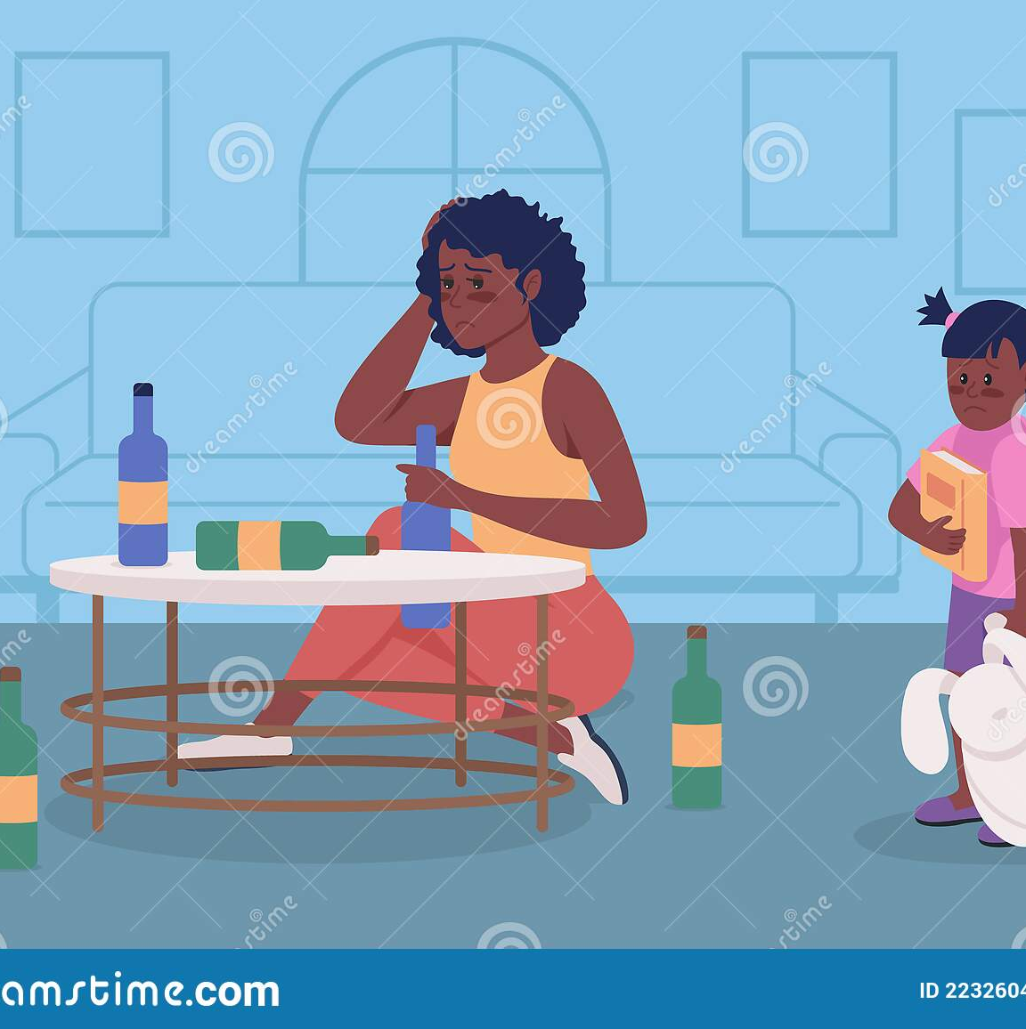
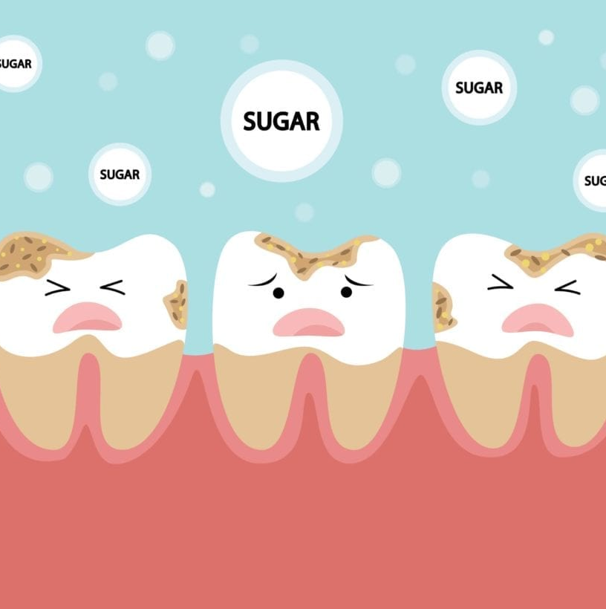
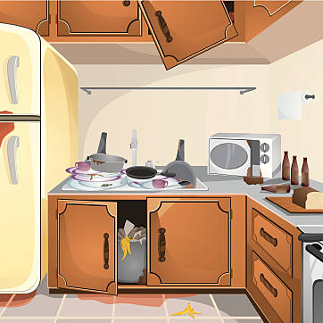
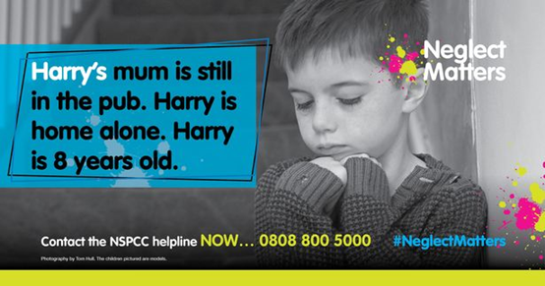
Neglect is the persistent failure to meet a child’s basic physical and/or psychological needs, likely to result in the serious impairment of the child’s health or development
Notes:
Neglect is the most common type of child abuse. It often happens at the same time as other types of abuse.
Neglect may occur during pregnancy as a result of maternal substance abuse. Once a child is born, neglect may involve a parent or carer failing to:
a. provide adequate food, clothing and shelter (including exclusion from home or abandonment)
b. protect a child from physical and emotional harm or danger
c. ensure adequate supervision (including the use of inadequate caregivers)
d. ensure access to appropriate medical care or treatment
It may also include neglect of, or unresponsiveness to, a child’s basic emotional needs.

Slide 22
Can you think of some signs & indicators of neglect?
Notes:
Appear over tired
Consistently dirty & unkempt
Illheatlh
Inadequate clothing
Appear hungry or steal food
- Be frequently absent or late OR arrive early and want to stay late
Neglect can be difficult to identify. Isolated signs may not mean that a child is suffering neglect, but multiple and persistent signs over time could indicate a serious problem and show that support given has not resulted in sustained changed. For this reason it is very important to record individual incidents and concerns clearly to build up a picture of what is happening over time to truly understand the lived experience for the child. Research indicates that experience of chronic neglect affects every aspect of a child’s development, their health will suffer and there are significant consequences in terms of social relationships and emotional wellbeing.
Research In Practice triennial analysis of serious case reviews learning for education document highlighted that school staff accustomed to working in areas of high deprivation can become desensitised to the warning signs of neglect. Providing immediate support for children in poverty – such as breakfast clubs, clothing, meals is important but we must remember this does not equate with children being safe.
Example that highlights to be curious:
You may have heard about the case of Daniel Pelka in the news. He was a little boy who died in 2012 and his mother and step-father were convicted of his murder. Daniel was reported by school to take food from other children and out of the bin. Mother reported that Daniel stole food at home and should be stopped and so this is what the school did. We now know that Daniel was being significantly abused and neglected at home and was starving. *Remember to be curious* consider what different reasons for a child’s behaviour or presentation may be – *discuss with the DSL*
Other resources for key points:
Child abuse and neglect guidance | Social care | NICE Communities | About | NICE
LSCB Neglect Video: Michelle's Story – YouTube
https://hillingdonsafeguardingpartnership.org.uk/wp-content/uploads/2024/11/Neglect-Strategy-2024.pdf

Slide 23
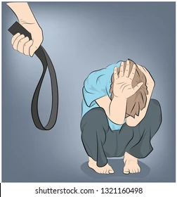
Physical Abuse
Is a form of abuse which may involve hitting, shaking, throwing, poisoning, burning or scalding, drowning, suffocating or otherwise causing physical harm to a child.
Physical harm may also be caused when a parent or carer fabricates the symptoms of, or deliberately induces, illness in a child.
Notes:
Fabricated illness is rare, but it can and does happen and can cause children to have unwarranted medical tests. It is also harmful in respect of their mental health and wellbeing.

Slide 24

In the UK what is the law regarding physical chastisement?
A: It is illegal for a parent to smack, or otherwise physically chastise a child unless it is ‘reasonable punishment’
B: It is legal to smack or physically chastise a child if you are their parent
Notes:
Do you know the law in the UK regarding physical chastisement?
In the UK it is unlawful for a parent to smack, or otherwise physically chastise a child, unless it is ‘reasonable punishment’. Reasonable has different meanings to different people. However, when it comes to safeguarding the guidance is clear that any chastisement that leaves a mark (red mark or bruising), or involves an implement (eg. wooden spoon, slipper, stick, belt) is a child protection concern and must be reported to Social Care as soon as possible.

Slide 25
Can you think of some signs & indicators of Physical Abuse?
Notes:
Any injury with no valid explanation
Serious injuries that haven’t been seen by a GP or hospital
Injuries on parts of the body not normally at risk in general games and play
Facial injuries are always a cause for concern and should be questioned
Jumpiness, edginess, or being generally fearful
Very afraid of getting into trouble
Overly eager to please

Slide 26
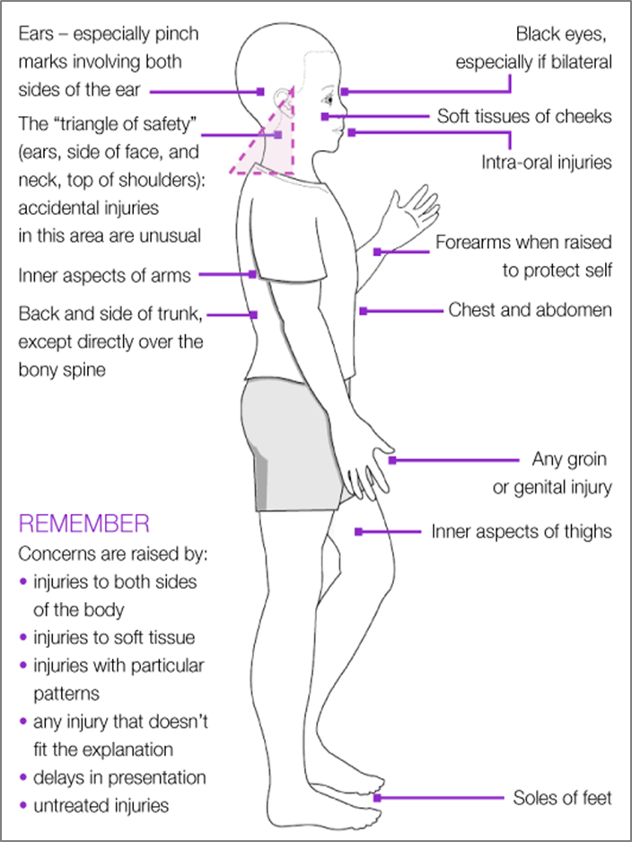
Notes:
It is not your responsibility to make difficult judgements about the cause of suspicious marks/injuries to a child – this is the role of consultant paediatrician as part of a child protection medical assessment. All children will occasionally suffer bumps and knocks as part of growing up, these marks will usually be on the bony areas of the body – forehead, elbows, knees, shins – and there will be an explanation that matches what you see. The diagram on the right shows areas of the body where accidental injury is not usually seen. Any injuries that are bilateral, have a particular pattern, don’t match explanation, are untreated or are on areas of soft tissue are potentially suspicious. If you have a direct disclosure from a child that a parent has caused an injury this should be referred to social care as a child protection issue and a discussion held about how and when to inform parents.

Slide 27
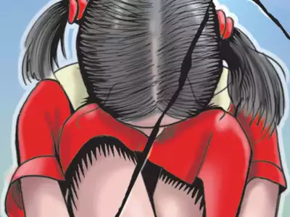
Sexual Abuse
Forcing or enticing a child or young person to take part in sexual activities, not necessarily involving violence, whether or not the child is aware of what is happening.
Sexual Abuse includes both physical contact and non-contact behaviours, for example showing a child sexual images or grooming
It can occur online, online grooming can facilitate ‘real world’ offences
Women can commit sexual offences
Children can be sexually abused by other children
Notes:
The activities may involve physical contact, including assault by penetration (for example rape or oral sex) or non-penetrative acts such as masturbation, kissing, rubbing and touching outside of clothing. They may also include non-contact activities, such as involving children in looking at, or in the production of, sexual images, watching sexual activities, encouraging children to behave in sexually inappropriate ways, or grooming a child in preparation for abuse.
Abusers will often try to build an emotional connection with a child in order to gain their trust for the purposes of sexual abuse. This is known as grooming. We must be alert to the fact that sexual abuse can occur within a family. Grooming can often be by someone who has frequent access to the child for example a parent, family member, sibling, family friend etc.
Sexual abuse can take place online, and technology can be used to facilitate offline abuse. Research highlights that online child sexual abuse can have as much of an impact on a child as abuse that only takes place offline and can lead to the same psychological difficulties (Hamilton-Giachritsis et al, 2017).
Online sexual abuse: (This is a real issue for now for children with the rise of mobile phones and social media and needs to be a big focus for school staff to educate).
Give some perspective:
.The Internet Watch Foundation – IWF – in 2012 removed 13,000 web pages from the internet – in 2023 they removed 275,652 web pages. Each single web page has thousands of images – so that equates to millions of images of children being sexually abused. Images often of girls 11-13 but they are getting younger and there is a big increase in images of boys too.
92% of images removed contained “self generated” content of children aged 7-10yrs ( manipulated, coerced – often in their own bedroom. Parents unaware). “self generated” not a helpful term as these children are being coerced, manipulated and blackmailed for the images.
The term ‘self-generated’ imagery refers to images and videos created using handheld devices or webcams and then shared online. Children are often groomed or extorted into capturing images or videos of themselves and sharing them by someone who is not physically present in the room with them, for example, on live streams or in chat rooms. Sometimes children are completely unaware they are being recorded and that there is then a image or video of them being shared by abusers. Many of these images are taken at home in children’s bedrooms or in family bathrooms when the child is alone or with another child such as a sibling or friend.
'Self-generated' material is something that has risen year on year and a trend we are constantly monitoring. We are now seeing much younger children appearing in this type of abuse imagery. For this reason, the IWF took a closer look to provide an insight into what’s going on – here is the analysis using case studies that can be shared and discussed afterwards about sexual recording of 3-6 years old's on devices - https://www.iwf.org.uk/annual-report-2023/case-studies/sexual-recordings-of-3-6-year-olds-via-online-devices/
Remember* We must challenge our own stereotypes of who an abuser can be. Women can and do sexually abuse children as well as men. Children can also sexually abuse other children.

Slide 28

Notes:
We don’t have reliable statistics on the prevalence of sexual abuse –the most regularly reported statistic is that 1 in 20 children are sexually abused - this is because many people will wait until years, sometimes decades later to report. Victims can also be very young, and have disabilities, that make them less able to understand or communicate that what is happening to them is wrong. Children may feel shame, or feel conflicted about what is happening because they like the person that it is hurting them, or because they have been threatened that nobody will believe them, or that something terrible will happen if they tell.
Children who are disabled are particularly vulnerable to abuse and neglect, especially sexual abuse, this is likely to their experience of multiple caregivers and their specific challenges in seeking help. Adults should be vigilant as to any changes in behaviour that could indicate a child is being abused. Any disclosure of sexual abuse must be reported to social care/police as a child protection issue and should not be discussed with parents first. The Truth project has been hearing testimony from 2984 survivors of CSA – of those 79% have reported abuse starting before the age of 11.
Intrafamilial sexual abuse - refers to child sexual abuse that occurs within the family environment. Abuse may involve relatives, or others (such as foster carers or a parent’s partner) who feel like family from the child’s point of view. The family environment is a common context in which child sexual abuse occurs, accounting for almost half of all child sexual abuse offences reported to the police in England and Wales.
Intra-familial sexual abuse often occurs in combination with other forms of physical or emotional abuse or neglect, and there is evidence of close relationships between child abuse and domestic violence, between sexual abuse in childhood and sexual victimisation in adolescence, and between intra-familial and extra-familial victimisation.
Child sexual abuse in the family often starts at a younger age than extra-familial abuse and may go on for many years. Abuse by a family member, particularly a parent or carer, may be especially traumatic because of the betrayal, stigma and secrecy it involves. For those who are abused, it has been linked to poor physical and mental health, lower income, relationship difficulties and re-victimisation across the life course.
Much child sexual abuse in the family remains unidentified. Children may be afraid of their abuser(s) or not want them to get into trouble; they may believe the abuse was ‘their fault’, fear what might happen to their family if they tell, or not recognise their experience as abuse.
https://www.bbc.co.uk/iplayer/episode/p0g30b72/the-issue-my-grandfather-the-abuser-poppys-story – half an hour documentary, really worth a watch for all staff to help them think this could be happening to a child.
Sibling sexual abuse is estimated to be three to five times more common than parent to child sexual abuse. SSA is more likely to occur when children have experienced abuse, neglect or have a convicted sex offender within their close network.
Do not rely on verbal disclosures. Consider behaviour that indicates something harmful may be happening such as using inappropriate language, playing with toys in a sexual way, not wanting to spend time with certain people.
Instead of using language such as 'perpetrator' and 'victim', it can be helpful to use language which reaffirms that we are working to safeguard both children. Terms such as 'child who has harmed’ and 'child who has been harmed' can help everyone involved to remember both are children, first and foremost. Avoid language that minimises the abuse or implies consent for the child that has been harmed.
Other resources:
https://hillingdonsafeguardingpartnership.org.uk/wp-content/uploads/2022/08/Sibling-Sexual-Abuse-Briefing.pdf
Communicating with Children with Disabilities Briefing - Children with physical and learning disabilities, and children from some minority ethnic communities, may face additional barriers to seeking help. It is therefore crucial that professionals are alert to signs of child sexual abuse and confident to offer appropriate support. Professionals need to be trustworthy, authentic and empathic, facilitate choice, control and safety, and provide advocacy.

Slide 29
Can you think of some signs & indicators of Sexual Abuse?
Notes:
Changes in behaviour – a child may start being aggressive, withdrawn, clingy, have difficulties sleeping or start wetting the bed.
Avoiding the abuser – the child may dislike or seem afraid of a particular person and try to avoid spending time alone with them.
Sexually inappropriate behaviour – children who have been abused may behave in sexually inappropriate ways or use sexually explicit language.
Physical problems – the child may develop health problems, including soreness in the genital and anal areas or sexually transmitted infections, or they may become pregnant.
Problems at school – an abused child may have difficulty concentrating and learning, and their grades may start to drop.
Giving clues – children may also drop hints and clues that the abuse is happening without revealing it outright.
Centre of Expertise on Child Sexual Abuse has excellent resources for schools. Including:
Signs & Indicators Template - CSA Centre
Bitesize videos: helpful to illustrate key points
The scale and nature of child sexual abuse in England and Wales (02/12) - YouTube
Recognising the barriers to conversations about sexual abuse (06/12) – YouTube
Being confident in responding to concerns of child sexual abuse (07/12) - YouTube
Helpline - Stop It Now - give anonymous support and advice to anyone with concerns about child sexual abuse, whether this is your own or someone else’s behaviour. Our helpline is a safe space for callers to talk about their concerns and questions.
Language and CSA

Slide 30




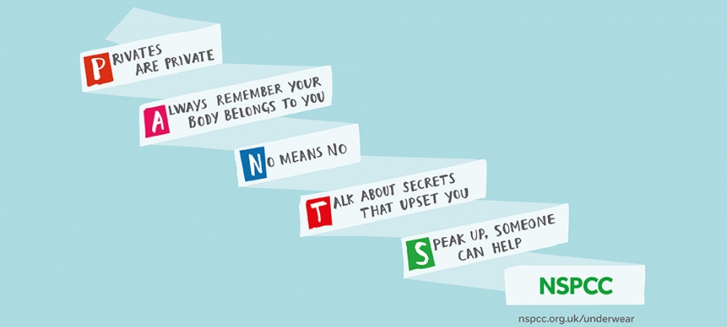

Notes:
Educators are in the position to give children the tools they need to seek help if they need
NSPCC PANTS rule are really useful with younger age groups - PANTS resources for schools and teachers | NSPCC Learning
Talk Relationships: resources to deliver sex and relationships education | NSPCC Learning – aimed at secondary school currently but looking to deliver to primary schools. Are you signed up?
CEOP Safety Centre
Videos | Childline – on a range of topics. What makes them better is that they are done by children for other children. I find this can have more impact. Will need to be checked to decide which age group would be appropriate.
However, their Toolbox has lots of videos for a variety of ages - Toolbox | Childline
Internet Watch Foundation has a tool that allows children to take control of their own online images if they want them removed. This can be easier for some children if they can’t tell an adult for whatever reason.
Please highlight to staff/children/parents. Report Remove (iwf.org.uk)
Helpline - Stop It Now - give anonymous support and advice to anyone with concerns about child sexual abuse, whether this is your own or someone else’s behaviour. Our helpline is a safe space for callers to talk about their concerns and questions.

Slide 31

Emotional Abuse
The persistent emotional maltreatment of a child such as to cause severe and persistent adverse effects on the child’s emotional development.
Making a child feel they are worthless, unloved, inadequate or only have value insofar as they meet the needs of another
Seeing or hearing the ill-treatment of another
Serious bullying, including cyber bullying
Making fun of them, or silencing their views
Exploiting or corrupting them
Having unrealistic expectations
Causing them to feel frightened, or in danger
Notes:
There is an element of emotional abuse in all types of abuse and neglect, however it can also be a form of abuse in it’s own right.
The key words within the definition are severe and persistent
Emotional abuse can be both active or passive – examples include a parent deliberately belittling their child, or simply being unable to recognise and respond to a child’s emotional needs due to their own issues – for example severe mental health issues

Slide 32
Can you think of some signs & indicators of Emotional Abuse?
Notes:
Seem to lack confidence and/or self assurance
Act in an age-inappropriate way
Lack social skills
Find it difficult to make or maintain relationships
Struggle to control their emotions and/or have extreme outbursts
Use language you wouldn’t expect them to know
Have few, or no friends, appear isolated in their family

Slide 33
Sharing Information
Child tells teacher they feel sad
TA sees child appears tired
?
Lunch Supervisor overhears the child talking to friends about being hungry
Attendance officer notes a sudden increase in lateness to school
Notes:
Within your school the DSL has to make fine decisions about children who are in need of early help, CIN support, or child protection services. They can only do this on the basis of information that has been shared with them. Often it is the combination of different information that highlights a concern. If you have a concern about a child be sure that you follow your reporting and recording practices.
If your not sure about something then discuss it with your DSL. Child abuse is not easy to define so don’t feel stupid raising something.
It can feel like you are judging someone –abusive acts aren’t always intentional however, this doesn’t stop them being abusive. Remember focus on the child.
You can reference learning from the Child Safeguarding Practice Review Panel into the deaths of Star Hobson and Arthur Labinjo-Hughes – A main area for improvement was the sharing of information with multi agency partners at key times, ensuring timely strategy meetings are held.

Slide 34
Domestic Abuse
Domestic abuse is defined as: any incident, or pattern of incidents, of: controlling, coercive, threatening behaviour, violence or abuse between those aged 16 or over who are, or have been, intimate partners or family members regardless of gender or sexuality.
1:4 Women experience domestic abuse
1:6 Men experience domestic abuse
In the UK 2 women are killed every week due to domestic abuse
Notes:
Domestic abuse is a gendered crime – the majority of victims are women in heterosexual relationships. For both women and men the majority of perpetrators of domestic abuse are male. Any incident of domestic abuse the police attend where a child lives is notified to social care – it is the most common reason for contact with statutory social work services. However research by the Crime Survey for England and Wales found that only 18% of victims reported in the last year. Therefore we can see that domestic abuse must be happening, and going unreported. As frontline workers school staff might be able to identify cases of domestic abuse before any other agency.
Remember that even if children are not in the room where an incident may have occurred they are still considered to have been exposed to it if they are in the same household. They are likely to have been aware or have heard what was happening and this can have the same impact on them or in some cases this can be even more of a frightening experience.
2022 – NSPCC = January 2022 marked the start of children being officially recognised as victims of domestic abuse in the Domestic Abuse Act.
Local support - contact the Hillingdon Domestic Abuse Advocacy Service (HDAAS) in confidence (Monday to Friday, 9am to 5pm) by emailing hdaas@hillingdon.gov.uk or calling 07874 620954

Slide 35
Mental Health Difficulties
Physical Symptoms
Emotional Difficulties
Social Difficulties
anxiety, hyper-vigilance, depression, flashbacks, nightmares, self injury and trouble sleeping
tummy/head aches, bed wetting, injuries
emotional response, aggression, withdrawal, low self- esteem and self worth,
‘Acting out,’ truancy, isolated from friends
Notes:
Exposure to domestic abuse is recognised as one of the most harmful experiences for children. As can be seen it can impact every aspect of development. Children exposed to DA experience ongoing social, emotional and mental health difficulties – they could learn to normalise the violence they are exposed to.
Think for a moment about a time when you found yourself walking alone in place you probably ought not to have been –it’s late, it’s dark and you are alone and aware of everything around you that could indicate danger. This is hyper-vigilance.
Protecting children from domestic abuse | NSPCC Learning – short video at end of web page

Slide 36
Harmful Practices
Forced Marriage
What is a harmful practice?
Harmful practices are persistent practices and behaviours that are grounded on discrimination on the basis of sex, gender, age and other grounds as well as multiple and/or intersecting forms of discrimination that often involve violence and cause physical and/or psychological harm or suffering.
Breast Flattening/Ironing
‘Honour’ Based Violence
Notes:
Harmful practices are persistent practices and behaviours that are grounded on discrimination on the basis of sex, gender, age and other grounds as well as multiple and/or intersecting forms of discrimination that often involve violence and cause physical and/or psychological harm or suffering (UNCRC, UNCEDAW). They can be traditional, emerging or re-emerging practices.
They are usually committed by the child’s parents or significant adults within the child’s/young person’s community and seen as a misguided attempt at protection
Harmful practices disproportionately affect girls and women, but can affect boys and men too
Individuals affected by harmful practices often experience poly-victimisation – they have often experienced more than one type of abuse, so it’s always important to holistically risk assess – ask yourself – what else could be happening? To the girl, to siblings etc.
We know there are links between various harmful practices, e.g., FGM and early forced marriage – don’t make assumptions, but be professionally curious and explore all avenues when risk assessing
Some examples of harmful practices:
Honour’ Based Violence/abuse: Is a form of violence/abuse that is committed to defend or protect the ‘honour’ of a family or community when an individual has expressed views, or acted in a way, that transgresses family/community norms and expectations or ‘honour codes’. This can lead to physical, emotional and sexual violence, forced marriage, threats to kill, isolation, being held against their will, and other violence.
Forced Marriage (different to arranged marriage) - is a marriage conducted without the consent of both parties and where duress is a factor. Duress can include threats, intimidation, physical sexual or emotional violence etc. Forced Marriage is a criminal offence – civil orders can be sought to prevent a forced marriage (Forced Marriage Protection Order – anyone can apply for these, even the person needing protection themselves)
Breast flattening/ironing – had you heard of this? It highlights that if you hear something that seems unusual it doesn’t mean it isn’t true – *Be curious* speak to your DLS, check it out. It is a practice whereby the developing breasts of a girl (usually pre-pubescent) are pounded with an implement, and/or bound, to prevent development and ‘protect’ from unwanted male attention
Child abuse linked to faith or belief: Belief in witchcraft, spirit possession and other forms of the supernatural leading to children being blamed for bad luck, accused of as being witches, possessed by evil spirits/djinns and subsequently abused. Fear of the supernatural is also known to be used to make children comply with being trafficked for domestic slavery or sexual exploitation. Notable cases you may have heard of include Victoria Climbie, Ayesha Ali, Kristie Bamu, Khyra Ishaq

Slide 37
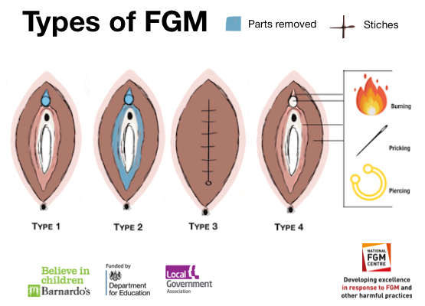
Female Genital Mutilation (FGM)
Notes:
Female genital mutilation (FGM) is the partial or total removal of external female genitalia for non-medical reasons. It's also known as female circumcision or cutting; it bears no resemblance to male circumcision. It can occur at any age of a girl’s life, and can be undertaken on more than one occasion.
FGM is a crime in the UK. In early 2019 the first (and still the only) criminal conviction was made – this related to a 3 year old little girl in Croydon, whose mother was convicted.
FGM is child abuse.
Any concerns relating to it must be reported to the police/social care. There are no medical reasons to carry out FGM. It's dangerous and carries serious health risks, it is usually completed without anaesthetic and can result in severe bleeding and death. Individual professionals have a personal reporting duty in ‘known’ cases.
Approximately 10,000 girls aged under 15 who have migrated to England and Wales are likely to have undergone FGM. Girls are known to be at significantly increased risk if a family member has previously undergone the procedure (mother, older sibling, cousin etc), concern can be raised by a child talking about or being withdrawn from school to travel to an affected community for ‘a special procedure’ or ‘that she is going to become a women soon’. Summer holidays are particularly high risk time – euphemistically known as ‘the cutting season’.
The home office has free FGM E-learning which we would recommend all staff complete as good practice- http://www.fgmelearning.co.uk/. The Government guidance on FGM is updated and also has lots of useful information on the subject - Female genital mutilation: resource pack - GOV.UK (www.gov.uk)
Local Authority Training

Slide 38
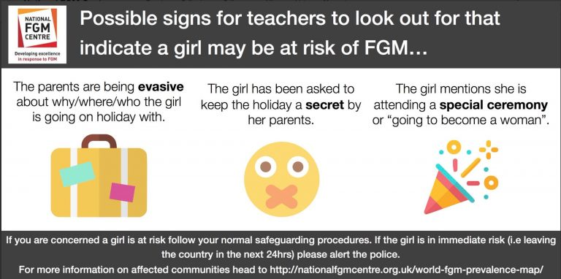
It is important to build a picture of the risk – a girl travelling to a country of prevalence alone is not an indication of FGM and does not warrant a referral to children’s social care.
Notes:
FGM is not a part of any religion.
Many affected communities believe that FGM is necessary to ensure the girl is accepted by the community and eligible for marriage, as it will ensure her chastity. FGM is a global issue – it happens in South America, Africa, the Middle East, Asia, Europe, Russia and everywhere else there are diasporic communities - the only continent where it doesn’t happen is Antarctica .
FGM is child abuse and a crime in the UK punishable up to 14 years in prison. Like forced marriage protection orders, FGM protection orders can be applied for to protect girls and women at risk – anyone can apply for these – even the person at risk themselves.
There are no medical reasons to carry out FGM - It's dangerous and carries serious health risks:
Short-term:
Death
Broken bones from being held down for the procedure
Infections
severe pain
excessive bleeding
urinary problems, such as urinary retention
wound infections including blood born viruses
Long-term:
•Repeated urine infections / vaginal infections
•Difficulties with menstruation
•Keloid scarring and other scars
•Infertility
•Chronic infections
Mental health problems
FGM can happen at any time, and within the UK too. Reinforce the message that this is not something that only happens in a village in Africa (as is so often thought) but now we have more medicalisation of FGM – e.g. so taking place in a hospital in Egypt by a doctor.
The National FGM Centre, have a FGM prevalence map. You can use it to have a quick discussion with Staff about using it to help build a picture of risk – are you capturing ethnic group data? - this is crucial for harmful practices cases - use the info on the map to help build up a picture of risk to the girl.
http://nationalfgmcentre.org.uk/world-fgm-prevalence-map/
http://nationalfgmcentre.org.uk/wp-content/uploads/2019/01/FGMPO-Leaflet.pdf
THE NFGMC has lots of resources you can access to use with children and don’t forget to remind staff of FGM packs which went to your school – including the flash card pack.

Slide 39
Teaching, Health and Social Care Professionals have a personal mandatory reporting duty to report 'known' cases of FGM in Girls under 18 years to the police (101) in the area where the child lives. A 'known' case is one where the professional is given a verbal disclosure by the girl and / or the professional physically sees what they believe to be FGM.
Notes:
A mandatory reporting duty means you must report this directly to the police on 101 yourself – you cannot delegate this to your DSL, although do lean on them for support
Any other cases where you suspect a girl may be at risk of FGM should be followed through with your normal safeguarding procedures
Overall Key points:
FGM doesn’t often work in isolation – so it’s important to holistically risk assess – what else could be happening, if anything?
Main trends are that the age of FGM is decreasing, and the medicalisation of FGM is increasing
Having a conversation with a parent where you have a concern around FGM, just like you do with other issues, should be a step you take (unless of course it would put a girl at risk)
Are all your staff trained, or at least aware? Teachers may not be the ones girls disclose to
Ofsted inspectors are increasingly asking schools about FGM; how teachers are being trained, pupils safeguarded etc. – what is your school doing?

Slide 40

What is contextual Safeguarding?
Notes:
Ask staff the question

Slide 41
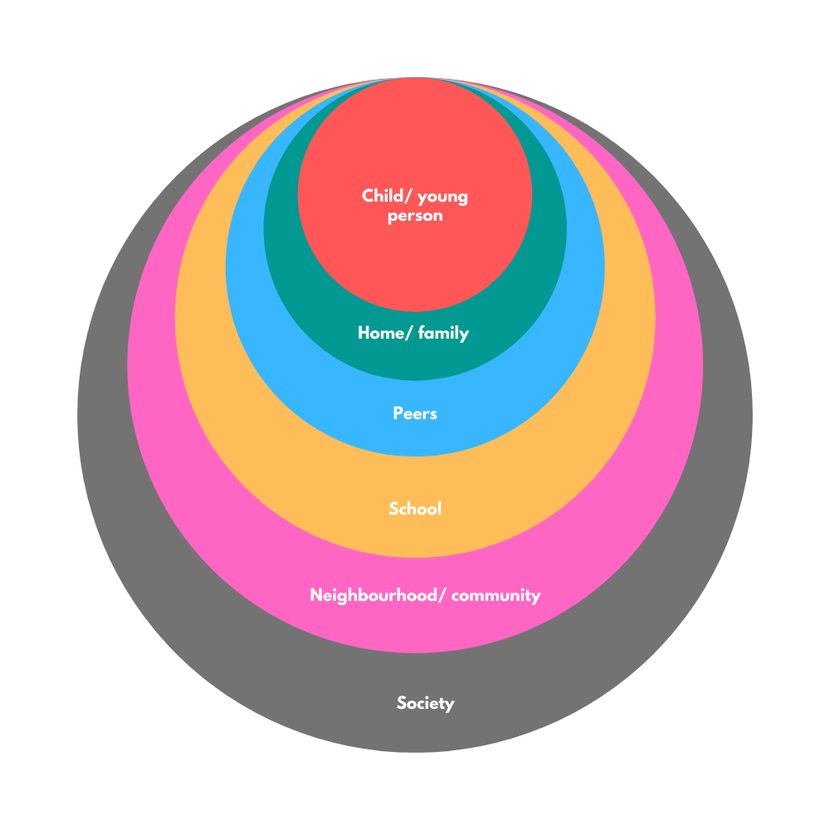
Contextual Safeguarding
Young people experience harm beyond their families
Parents have little influence over these wider contexts
Schools need to consider risks outside of immediate family context
Settings need to consider the location and culture of their school and identify any risks young people may be exposed to
Notes:
The harm we’ve focused on in the previous slides often refers to harm occurring within a child’s home/family setting. However, Contextual safeguarding recognises that the different relationships that young people form in their neighbourhoods, schools and online can feature violence and abuse. Parents and carers have little influence over these contexts, and young people’s experiences of extra-familial abuse can undermine parent-child relationships.
Schools are ideally placed to recognise, respond to and/or highlight any developing risks. For example, young people raising concerns about their peers or contexts where they spend time such as a local park or take-away or even the school toilets. Be alert and speak to your DSL with any worries.
Contextual Safeguarding - Hillingdon Safeguarding Children Partnership Arrangements (Hillingdon LSCB) (hillingdonsafeguardingpartnership.org.uk) – Video at bottom of web page – What is Contextual Safeguarding
Contextual-Safeguarding-Strategy.pdf

Slide 42
What do the acronyms stand for?
CSE
CCE

Slide 43
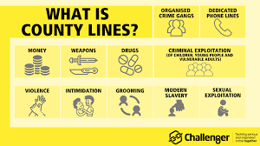
Child Sexual Exploitation (CSE)
Child Criminal Exploitation (CCE)
County Lines
Youth Violence
Axis
Notes:
Child sexual exploitation (CSE) is a form of child sexual abuse. It occurs where an individual or group takes advantage of an imbalance of power to coerce, manipulate or deceive a child or young person under the age of 18 into sexual activity
Usually in exchange for something the victim needs or wants, and/or
for the financial advantage or increased status of the perpetrator or facilitator.
Young people may be given things such as gifts, money, drugs, alcohol, status or affection in exchange for taking part in sexual activities. Young people may be tricked into believing they're in a loving, consensual relationship. They often trust their abuser and don't understand that they're being abused. This has been seen in a number of high profile cases – notably Rotherham and Oxford. The young person may depend on their abuser or be too scared to tell anyone what's happening. They might be invited to parties and given drugs and alcohol before being sexually exploited. They can also be groomed and exploited online.
The abuse can be perpetrated by individuals or groups, males or females, and children or adults. The abuse can be a one-off occurrence or a series of incidents over time, and range from opportunistic to complex organised abuse. CSE can affect any child or young person (male or female) under the age of 18 years, including 16 and 17 year olds who can legally consent to have sex. The victim may have been sexually exploited even if the sexual activity appears consensual. (Under 13 is always rape – they cannot consent)Whilst age may be the most obvious, this power imbalance can also be due to a range of other factors including sex, sexual identity, cognitive ability, physical strength, status, and access to economic or other resources.
Child Criminal Exploitation (CCE) Is where an individual or group takes advantage of an imbalance of power to coerce, control, manipulate or deceive a child or young person under the age of 18 into any criminal activity:
in exchange for something the victim needs or wants; and/or
for the financial or other advantage of the perpetrator or facilitator; and/or
through violence or the threat of violence.
The victim may have been criminally exploited even if the activity appears consensual. Child criminal exploitation does not always involve physical contact; it can also occur through the use of technology
County Lines – criminal gangs using young people to transport drugs/money/phones to other areas. There is evidence that increasingly younger children are being exploited through CCE, and that gangs are seeking to target children aged 10-12, as these children are less likely to be stopped by police. Therefore they are more likely to be ‘successful’ in meeting the aims of the perpetrators, and earning them money. Children can experience extreme violence and threats against their families to coerce them into continuing to ‘work’ for the gang/network.
BBC iPlayer - County Lines Documentary worth looking at.
In Hillingdon we have a specialist organisation (AXIS) working to analyse soft and hard intelligence about exploitation and seeking to disrupt this through targeted youth work, and involvement of statutory agencies where required. Axis are keen to hear any information from schools even if seemingly small it could build to create a much bigger picture of something that is happening. This is why it is even more important to share any information you have with your DSL – for example if you overhear conversations between peers about things that might be happening in the community.

Slide 44

What is Cuckooing?
Cuckooing is a form of exploitation where criminals take over someone’s home to use it as a base for illegal activities such as drug dealing, county lines or facilitating other crimes. Victims are often left with little choice but to cooperate.
Notes:
“Cuckooing” (also known as “forced home invasion”) – a tactic used by criminals, typically drug dealers, to take over the homes of vulnerable individuals, such as care leavers or those with addiction, physical or mental health issues, and use the property as a base for criminal activity. This is a common characteristic of the county lines business model and can occur in a range of settings such as rental and private properties, student accommodation, prisons, and commercial properties.
Coerced internal concealment (also known as “plugging”) – the practice whereby a child or vulnerable adult is controlled or coerced into concealing drugs internally as a method of transportation to avoid detection. Drugs or sim cards are usually concealed within a condom or similar packaging and inserted into a bodily orifice (rectum or vagina) using lubricant or swallowed.
Debt bondage – a form of entrapment when a victim owes money to their exploiters and is made to repay their debt, either financially or through another means such as transporting drugs. The exploiter may groom the victim by initially providing money or goods which the victim will then be made to pay back. The exploiter may also deliberately manufacture a debt, for example by staging a robbery of drugs or cash in the victim’s possession in order to extort money from families or to ensure the victim will continue to perform tasks for them. The debt may also be inherited from parents and siblings

Slide 45
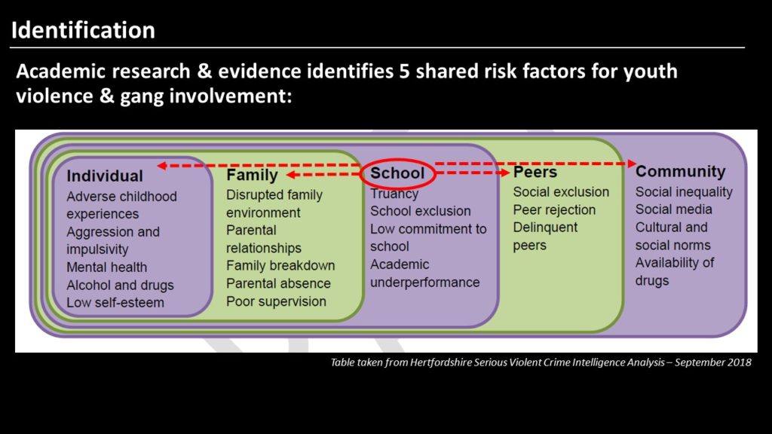
Serious Youth Violence
Notes:
Youth Violence is a safeguarding issue. All staff need to be aware of the risks to the health and wellbeing of young people who are drawn into youth violence and gangs. Risk factors on slide.
Youth Violence is a safeguarding concern and should be responded to as such, in addition to using behaviour policies (where appropriate). Consider for example a YP who brings a knife into school – in addition to following behaviour policies we should be considering what it is that has caused that child to feel the need to do this – are they being threatened? Are they afraid? Have they been groomed as part of criminal exploitation? As with all safeguarding issues be curious – what is beyond the immediate presentation?
*We need to connect in order to correct* - speaking to young people and trying to understand what is going on for them is vital in helping to keep them safe.
Often perpetrators are also victims (thin line) – victims can become perpetrators because they no longer want to be victims/they feel they have no choice – we must consider young people both when responding to incidents.
All staff should be aware of indicators, which may signal that children are at risk from, or are involved with serious violent crime. These may include increased absence from school, a change in friendships or relationships with older individuals or groups, a significant decline in performance, signs of self-harm or a significant change in wellbeing, or signs of assault or unexplained injuries. Unexplained gifts or new possessions could also indicate that children have been approached by, or are involved with, individuals associated with criminal networks or gangs and may be at risk of criminal exploitation.
All staff should be aware of the range of risk factors which increase the likelihood of involvement in serious violence, such as being male, having been frequently absent or permanently excluded from school, having experienced child maltreatment and having been involved in offending, such as theft or robbery.
Further information is available in the Home Office’s Preventing youth violence and gang involvement and its Criminal exploitation of children and vulnerable adults: county lines guidance.
Serious-Youth-Violence-Briefing-.pdf
In Hillingdon we have a specialist organisation (AXIS) working to analyse soft and hard intelligence about exploitation and seeking to disrupt this through targeted youth work, and involvement of statutory agencies where required. Axis are keen to hear any information from schools even if seemingly small it could build to create a much bigger picture of something that is happening. This is why it is even more important to share any information you have with your DSL – for example if you overhear conversations between peers about things that might be happening in the community.

Slide 46
Can you think of some signs & indicators of CSE, CCE, county lines & Serious Youth Violence?
Notes:
Ask staff before showing next slide.

Slide 47
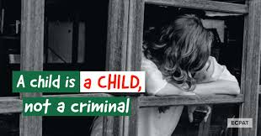
Persistently going missing, being found out of area
Parental concerns
Suspicion of physical assault/unexplained injuries
Significant decline in school results/performance
Self-harm or significant changes in emotional well-being
unexplained money, clothes, or mobile phones
excessive text messages/ phone calls and/or having multiple handsets
Relationships with controlling / older individuals or groups
gang association or isolation from peers or social networks
Change in appearance (perhaps in particular style or colour)
STI or pregnancy
Carrying weapons
A new nickname, hand signals or code to communicate with friends
Tags or graffiti on books/possessions
Being secretive or vague about whereabouts or who spending time with
Notes:
Signs & Indicators of Exploitation:
Children who are being exploited have historically been seen as ‘the problem’. Fortunately, there is increasing awareness of the vulnerability of young people to being tricked, manipulated and groomed into exploitative situations. It is essential that we remember that children can not consent to their own abuse.
We must be conscious of the language we use for example ‘risk taking behaviour’, ‘Sexually promiscuous’ ‘danger to themselves’ ‘rebellious’ choosing the lifestyle’– this language can stop us recognising we are talking about a child victim.
Victim-blaming language may reinforce messages from perpetrators around shame and guilt. This in turn may prevent the child or young person from disclosing their abuse, through fear of being blamed by professionals. When victim-blaming language is used amongst professionals, there is a risk of normalising and minimising the child’s experience, resulting in a lack of appropriate response.
Stop – check your language – and check your own judgment – have you looked beyond a child’s presenting behaviours to see what might be going on?
‘They may have been groomed’ ‘A perpetrator may exploit the child's increased vulnerability’ ‘The child is vulnerable to being sexually exploited’
Resource - Child_Exploitation_Appropriate_Language_Guide_2022.pdf
Adultification bias is a form of racial prejudice where children of minority groups, typically Black and Asian children, are treated by adults as being more mature than they actually are. Think recent learning from Child Q scenario.
https://tce.researchinpractice.org.uk/
#LookCloser resources - Our campaign materials can be used year-round to raise awareness of child exploitation and abuse
CSE Warning Signs

Slide 48

Child on Child Abuse
Bullying (including cyber-bullying)
Physical Abuse
Abuse within intimate partner relationships
Sexual Violence/Harassment
Up-skirting
Sending of nude/semi nude images
Hazing
Remember not to view or forward images of children
Notes:
It is essential not to minimise the impact of abuse perpetrated by other children, depending on circumstances, it may require a response under behaviour policy, from safeguarding services, or from police when a criminal threshold is met. Students and staff should be clear about expectations for behaviour, and consequences of abusive conduct towards peers. This protects victims, and also means that any early help support for perpetrators can be provided to prevent their behaviour escalating.
Forms of child on child abuse include;
sexual violence, such as rape, assault by penetration and sexual assault; (this may include an online element which facilitates, threatens and/or encourages sexual violence);
•sexual harassment, such as sexual comments, remarks, jokes and online sexual harassment, which may be stand-alone or part of a broader pattern of abuse;
•sharing nudes and semi nudes images and or videos (also known as sexting or youth produced sexual imagery);
•initiation/hazing type violence and rituals (this could include activities involving harassment, abuse or humiliation used as a way of initiating a person into a group and may also include an online element);and
•upskirting, which typically involves taking a picture under a person’s clothing without them knowing, with the intention of viewing their genitals or buttocks to obtain sexual gratification, or cause the victim humiliation, distress or alarm.
All staff should be clear as to the school’s or college’s policy and procedures with regards to child on child abuse.
We should be clear that experience of sexual violence and/or harassment is not ‘part of growing up’ –When referring to sexual harassment we mean ‘unwanted conduct of a sexual nature’ that can occur online and offline. Be alert to indicators of ‘boys will be boys’ culture and challenge this. Challenging behaviours (potentially criminal in nature), such as grabbing bottoms, breasts and genitalia, flicking bras and lifting up skirts. Challenging it makes it easier to prevent situations escalating and encourages young people to appropriately challenge this behaviour in their peers also. Behaviours such as misogyny, slut shaming, victim blaming, and sexual harassment create an environment where sexual violence and abuse can exist and thrive.
It is essential that all victims are reassured that they are being taken seriously, regardless of how long it has taken them to come forward and that they will be supported and kept safe. Abuse that occurs online should not be downplayed and should be treated seriously. A victim should never be given the impression that they are creating a problem by reporting peer on peer abuse including sexual violence or sexual harassment. Nor should a victim ever be made to feel ashamed for making a report or their experience minimised.
We must also consider support needed for the potential perpetrator. Statistics show that around half of young people who have displayed harmful sexual behaviour have experienced sexual abuse themselves. What might be going on for this young person? What may their behaviour indicate?
Some of the specific forms of child on child abuse set out (for example, domestic violence and abuse) will not be specifically relevant for primary school aged children; however, other forms such as bullying, sexualised language, and/or sexualised behaviour will be relevant. It is particularly important these behaviours are addressed as soon as they are picked up to prevent them becoming normalised and the potential for them escalating.
In addition, the response to concerns/allegations of peer-on-peer abuse will differ depending on the age of the child or children in question. For example, the police will take a welfare rather than a punitive approach towards children aged under 10, which is the age of criminal responsibility in England and Wales.
It is important to note that children may not find it easy to tell staff about their abuse verbally. Children can show signs or act in ways that they hope adults will notice and react to. In some cases, the victim may not make a direct report. For example, a friend may make a report or a member of school or college staff may overhear a conversation that suggests a child has been harmed. As per Part one of this guidance, if staff have any concerns about a child’s welfare, they should act on them immediately rather than wait to be told. Victims may not talk about the whole picture immediately. They may be more comfortable providing information on a piecemeal basis. It is essential that dialogue is kept open and encouraged.
**Any person that sends/forward a nude/semi-nude picture of a child as classes as distributing child pornography – even if it is a child/young person sending a picture of themselves. Wherever possible school staff should not view these images and should never forward them on (even if just to share with DSL etc). However, whenever aware that these images have been sent they should alert the DSL immediately so that next steps an be explored.
Remember Key Guidance in this area: Part 5 KCSIE - sets out how schools and colleges should manage reports of child on child sexual violence and harassment
Links also DfE guidance May 2018 ‘Sexual Violence and sexual harassment between children in schools and colleges’
Sharing nudes and semi nudes: advice for education settings – UKCIS, 2020
Sharing nudes and semi-nudes: advice for education settings working with children and young people - GOV.UK (www.gov.uk)

Slide 49

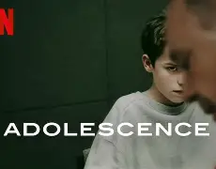
Incel – a term associated with a mostly online subculture of people, who define themselves as unable to find a romantic or sexual partner despite desiring one, and who may blame, objectify and denigrate women and girls as a result.
1 in 6 boys aged 6-15 have a positive view of Andrew Tate
Notes:
The growing national discussion around the Adolescence programme on Netflix is highlighting the world of Incels and we have gathered some useful tools, research and information to help raise awareness.
One in six boys aged 6-15 have a positive view of Andrew Tate | YouGov
Watch I Am Andrew Tate | Stream free on Channel 4
Watch The Secret World of Incels: UNTOLD | Stream free on Channel 4
BBC Three - Andrew Tate, The Dangerous Rise of Andrew Tate
This is a interesting report into the mental health response needed to identify and tackle this growing concern: Press release: 'Incels' need mental health support rather than a counter terrorism intervention, the world's largest study of incels finds (accessible) - GOV.UK
Interesting research that gives an understanding into the world of incels: Predicting harm among incels (involuntary celibates) - GOV.UK

Slide 50

Do you know what these Emojis mean?
Notes:
The red and yellow pill emoji is linked to incel, or “involuntarily celibate”, culture, where misogynistic and extremist views are prevalent. The meaning originates from The Matrix films, but has been adopted by the manosphere to represent those who see the “real truth” in the world.
The dynamite emoji is used in incel culture to represent the exploding red pill, in other words, breaking out of societal norms and myths.
The kidney beans emoji is tied to incel culture. It is thought to represent coffee beans, which link back to a series of memes mocking women.
The purple heart can be used to convey attraction or sexual desire.
The yellow heart may mean "I'm interested, are you interested?“
The pink heart can mean "I'm interested but not in sex.“
An orange heart is more likely to be platonic, and means "You're going to be fine.”
Full list here – https://hillingdon-my.sharepoint.com/:w:/r/personal/ndiamond_hillingdon_gov_uk/Documents/Pictures/emojis%20in%20adolescence.docx?d=w08b74504127a496fa916a3fdf4db20a3&csf=1&web=1&e=FR6L1m
Test out some others on staff.
Talking-about-misogyny-pack-final.pdf

Slide 51

Notes:
Teaching resources:
Sexism and Sexual Harassment - Leap
Whole_school_approach_to_sexism_and_sexual_harassment.pdf
How-to-take-a-whole-school-approach-1.pdf
Talking-about-misogyny-pack-final (1).pdf
Guidance_for_schools_on_preventing_and_responding_to_sexist__sexual_and_transphobic_bullying.pdf

Slide 52
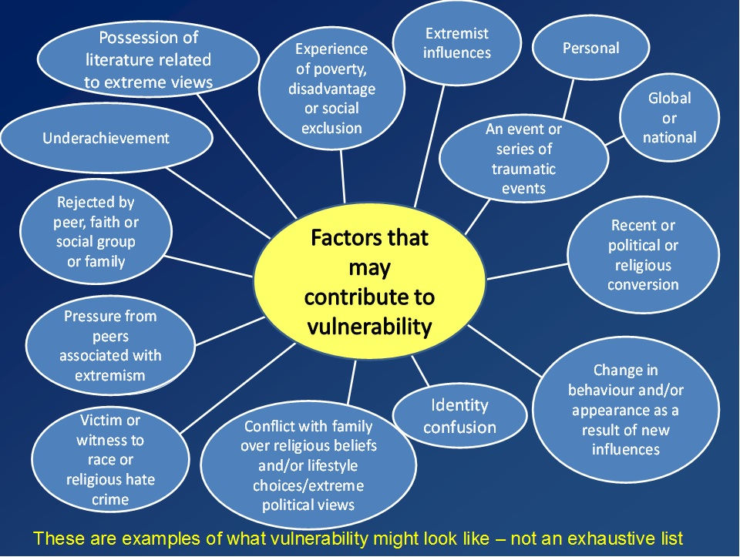
Radicalisation/Extremism
The Prevent Duty Guidance places a duty on schools, and child care providers, to have ‘due regard to the need to prevent people from being drawn into terrorism’.
Radicalisation is usually a process not an event.
All school staff should complete the Home Office e learning module: Introduction to Prevent. Senior Leaders and DSLs should complete the additional module around making referrals.
Notes:
Children and young people can be vulnerable to radicalisation, in the same way that they are vulnerable to other forms of grooming and exploitation. Early intervention to explore and challenge extremist ideology, whether that be so called Islamic extremism or the extreme far right, is effective in safeguarding children.
Usually, young people fall prey to radicalisation because they feel:
isolated and lonely
angry at the world
confused about the reasons for their misfortunes or situation
purposeless, without direction or hope
unprotected, lacking adult guidance.
If someone is radicalised by the far right, they might:
be hostile towards people from a certain country, religious group, sexual orientation or cultural background, especially Muslims
recite simplistic and prejudiced arguments about immigration and minorities, seeing them as a threat to ‘our way of life’ or blaming them for global or local issues
feel persecuted, referring to a ‘liberal, elite establishment agenda’ or ‘Jewish conspiracy’
see white Britons as under threat of racial and cultural extinction and say that they have to ‘take action’
share extremist or divisive views, especially on immigration and Islam, on their social media
significantly change their appearance and clothing
adopt the use of certain symbols associated with far-right or neo-Nazi organisations, distribute extremist literature, such as leaflets promoting far-right rallies
become increasingly secretive about their online activities.
If a child or young person you know exhibits some or all of the behaviours above, you should discuss this with your DSL.
However, in 2025 the local trends are showing an increase in cases with no clear ideology. There is also a rise in concerns around aggression, violence and misogynistic influences.
There was a shift being seen from radicalisation to extremism rather than terrorism and how events since October 2023 and the unrest during the summer 2024, including around the elections had changed the picture of what was being experienced.
Significance of the use of the online space to spread disinformation and escalate reactions and mobilise individuals was a shift and has had an impact upon communities.
Jewish and Muslim communities are also expressing their fearfulness which is at its highest in recent times.
There have been events of unrest and protest in relation to hotels in providing accommodation for asylum seekers (Epping) therefore, important to be aware of any children talking negatively about any asylum-seeking children as Hillingdon as the borough uses accommodation/hotels for this purpose and these things can escalate quickly.
Educate Against Hate, a , is a government website designed to support school teachers and leaders to help safeguard students from extremism and radicalisation.
The Home Office has developed three e-learning modules:
• Prevent awareness e-learning offers an introduction to the Prevent duty. https://www.elearning.prevent.homeoffice.gov.uk
• Prevent referrals e-learning supports staff to make Prevent referrals that are robust, informed and with good intention.
• Channel awareness e-learning is aimed at staff who may be asked to contribute to or sit on a multi-agency Channel panel. Welcome (prevent.homeoffice.gov.uk)
Part Five: THE PROCESS? (prevent.homeoffice.gov.uk) – The home office also has video examples to help identify concerns
Prevent duty e-learning courses are now available at www.gov.uk/prevent-duty-training.
Local live training sessions are bookable via learning zone: SCaN (See, Check and Notify), ACT Awareness, Prevent: A Spotlight on Extreme Ideologies, An Introduction to Prevent
Understanding and identifying radicalisation risk in your education setting - GOV.UK
Trust Your Instincts and Report | Action Counters Terrorism
Radicalisation and child protection | NSPCC Learning

Slide 53

Notes:
Modern slavery takes many forms including sexual exploitation, forced labour and domestic servitude, it transcends all demographics. Child Trafficking is a form of Modern Slavery, it occurs when children or young people are tricked, forced or persuaded to leave their homes and are moved or transported and then exploited, forced to work or sold. Can link to the recent high profile Mo Farah telling his story of child trafficking at the age of 9. It was PE teacher that he told! BBC One - The Real Mo Farah
Children can be trafficked for many reasons, including:
sexual exploitation
benefit fraud
forced marriage
domestic slavery like cleaning, cooking and childcare
forced labour in factories or agriculture
committing crimes, like begging, theft, working on cannabis farms or moving drugs (county lines)
Hillingdon is home to Heathrow airport, and on several main transport links. As a port authority we have a high proportion of unaccompanied minors entering the country through the airport, many of whom have been trafficked internationally. Trafficking also occurs on a national level – we have already considered the risks posed through criminal and sexual exploitation, if a perpetrator is moving or transporting children to exploit this is a form of child trafficking. There are local and national systems to protect trafficked children when they are identified (National Referral Mechanism)
Sign & Indicators – if the child is known to you: (Could you spot the signs of child trafficking? » STOP THE TRAFFIK)
If you already know the child, you may see a change in their behaviour. This can range from becoming withdrawn and reluctant to talk, to being aggressive and fearful of others.
Do any of the child’s family members appear to control their movements?
Are they always accompanied by an adult, despite previously having the freedom to move?
Has the child been taken out of school?
Have any new children recently moved into the family home?

Slide 54

14
18
28
88
318
Notes:
Do you know what these symbols relate too?
14, or Fourteen Words, is a Nazi symbol referring to the white supremacist slogan, “We must secure the existence of our people and a future for white children”.
18 is code for Adolf Hitler. The number comes from the position of the letters in the alphabet (1=A and 8=H). It’s commonly associated with the British white supremacist group Combat 18 or C18.
28 is a white supremacist code for Blood & Honour, a UK-based neo-Nazi music promotion network with branches across the world.
88 is a neo-Nazi code standing for Heil Hitler, the Nazi salute. The number 8 represents the letter H.
318 is code for British white supremacist group Combat 18 – 3 representing C, and 18 Adolf Hitler.
This is to highlight the growing concerns about young people being radicalised into the far right both nationally and in Hillingdon.
We live in unpredictable times and many people are confused and looking for answers. Sadly, this makes people, especially the young, more vulnerable to recruitment by the far right who exploit these fears to promote their racist agenda by giving them ready-made answers and a sense of purpose and belonging. As teachers, you have a duty to steer young people away from extremist narratives.
If someone is radicalised by the far right, they might:
be hostile towards people from a certain country, religious group, sexual orientation or cultural background, especially Muslims
recite simplistic and prejudiced arguments about immigration and minorities, seeing them as a threat to ‘our way of life’ or blaming them for global or local issues
feel persecuted, referring to a ‘liberal, elite establishment agenda’ or ‘Jewish conspiracy’
see white Britons as under threat of racial and cultural extinction and say that they have to ‘take action’
share extremist or divisive views, especially on immigration and Islam, on their social media
significantly change their appearance and clothing
adopt the use of certain symbols associated with far-right or neo-Nazi organisations, distribute extremist literature, such as leaflets promoting far-right rallies
become increasingly secretive about their online activities.
If a child or young person you know exhibits some or all of the behaviours above, you should discuss this with your DSL.

Slide 55

Online Safety
What are the risks?
Grooming
Cyber-bulling
Radicalisation
Sexual Image sharing/Sexting
Exploitation
Emotional abuse
Exposure to adult/ inappropriate
material
Notes:
Research has shown that children and young people view the online world as an extension of their daily lives. They do not make the same distinctions as most adults do between private and public. Children are spending increasing periods of time online (including most having access to the internet 24 hours a day) and we need to teach them to do so as safely as possible.
Example you can use to make the message more powerful:
Molly Russell – killed herself aged 14 after falling into a “vortex of despair” on social media. Family did not know but found graphic posts about suicide and self-harm on her Instagram account. Her Dad campaigned to get Instagram to remove the most harmful content. The Online Safety Bill has been passed - https://www.gov.uk/guidance/a-guide-to-the-online-safety-bill
content: being exposed to illegal, inappropriate or harmful content, for example: pornography, fake news, racism, misogyny, self-harm, suicide, anti-Semitism, radicalisation and extremism.
• contact: being subjected to harmful online interaction with other users; for example: peer to peer pressure, commercial advertising and adults posing as children or young adults with the intention to groom or exploit them for sexual, criminal, financial or other purposes’.
• conduct: personal online behaviour that increases the likelihood of, or causes, harm; for example, making, sending and receiving explicit images (e.g consensual and non-consensual sharing of nudes and semi-nudes and/or pornography, sharing other explicit images and online bullying; and
• commerce - risks such as online gambling, inappropriate advertising, phishing and or financial scams. If you feel your pupils, students or staff are at risk, please report it to the Anti-Phishing Working Group (https://apwg.org/).
Schools and colleges should carefully consider how this is managed on their premises and reflect in their mobile and smart technology policy and their child protection policy.
Signs of online abuse
A child or young person experiencing abuse online might:
spend a lot more or a lot less time than usual online, texting, gaming or using social media
seem distant, upset or angry after using the internet or texting
be secretive about who they're talking to and what they're doing online or on their mobile phone
have lots of new phone numbers, texts or email addresses on their mobile phone, laptop or tablet.
Multiple risks online:
Can use example of Brianna Ghey, who was brutally murdered by two teenagers who she thought were her friends. The part the internet had to play was two-fold. On the one hand Brianna’s mother believes her daughter was vulnerable after spending so much time online, lacking contact with her real-life friends. And on the hand, her mum said she also thinks Brianna would be alive if her killers had not been able to access violent content on the dark web as well as on the regular internet as they plotted her murder.
Breck's Last Game - Breck Bednar's Story: Grooming in Online Gaming Communities.
Over the course of a year, Breck was groomed online by an 18-year-old man through an online gaming community. The groomer used lies, manipulation and false promises to gain Breck’s trust. In 2014, Breck was murdered by his online groomer. The Breck Foundation provides a range of resources to help parents and professionals reduce the risk of harm through online grooming. Online Grooming and Sexual Abuse of Adults and Children.
When you are assessing risks around grooming or sexual abuse, think about people's online lives, in addition to their in-person relationships. Ask questions about online contacts and activity Find out how much time they spend online.
Talk about the risks of sharing private images online Talk about the difficulties of identifying people online Support people to understand how their own behaviour may harm or impact others too.
Remind people that sharing nude or indecent images online, even if it is a friend, sibling, boyfriend/girlfriend, can be a criminal offence.
Develop your own knowledge of how and why young and vulnerable people engage in technology assisted harmful sexual behaviour.
Breck Bednar's Story: Grooming in Online Gaming Communities Boys can be groomed and sexually exploited too.
Effective and creative education for children around safety in online gaming is vital.
Grooming: recognising the signs | NSPCC Learning
Promoting online safety for children | The Children's Society

Slide 56

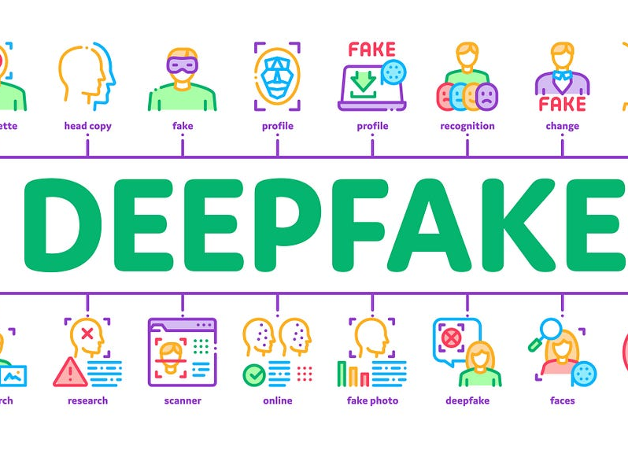
Notes:
New report by Internet Matters urges the new Government to crack down on AI-generated sexual imagery ‘epidemic’ after survey reveals 13% of teenagers have had an experience with nude deepfakes.
The possibility of uncontrolled nude deepfake abuse has sown fear into many children’s lives; over half of teenagers (55%) believe that it would be worse to have a deepfake nude created and shared of them than a real image.
Internet Matters calls for a ban on ‘nudifying’ tools, as the report warns it is simply too easy to create nude deepfakes online.
Recommended reforms to the school curriculum should include teaching children how to identify deepfakes and to use AI tech responsibly.
The report details an Internet Matters nationally representative survey of 2,000 parents of children aged 3-17 and 1,000 children aged 9-17 in the UKi, conducted by Opinium in June 2024. The survey shows:
A significant number of children have some kind of experience with a nude deepfake. Overall, 13% of children have had an experience with a nude deepfake (including sending or receiving one, encountering a nude deepfake online, using a nudifying app or someone they know having used a nudifying app). This means around half a million (529,632) teenagers in the UK, or 4 teenagers in a class of 30, have had an experience with a nude deepfake.
Teenage boys (18%) are twice as likely as teenage girls (9%) to report an experience with a nude deepfake, however boys are more likely to be creators of deepfake nudes, and girls are more likely to be the victims.
Most families have little to no understanding of deepfakes, with almost two thirds of children (61%) and almost half of parents (45%) saying that they don’t know or understand the term ‘deepfake’.
Families also agree that more education is needed on the topic of deepfakes. Only 11% of teenagers have been taught about deepfakes in school, and just 6% about nude deepfakes. The overwhelming majority of teenagers (92%) and parents (88%) feel that children should be taught about the risks of deepfakes in school.
AI-generated sexual imagery epidemic | Internet Matters.
DfE guidance on AI - Artificial Intelligence - DfE Guidance
https://www.childrenscommissioner.gov.uk/resource/children-nudification-tools-and-sexually-explicit-deepfakes/

Slide 57
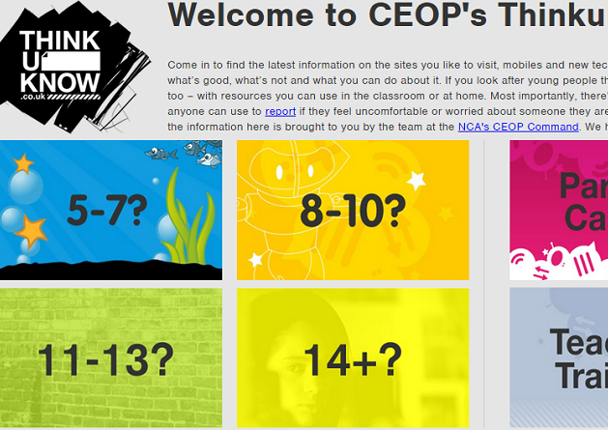
What can help?
Open and honest discussions around positives and negatives of the online world
Use of resources (ThinkUknow) to enable children to seek help when needed
Informing parents
Notes:
KCSIE Annex lots of links for children & yp, parents and professionals RE online safety:
Some of the resources:
E-safety for schools | NSPCC Learning
Parents and Carers - UK Safer Internet Centre
Broadband and Beyond - Safeguarding (lgfl.net)
Teaching about safeguarding issues can prevent harm by providing children and young people with skills, attributes and knowledge to they need to identify risk online and access help when they need it. Addressing sensitive issues promotes a whole setting approach to safeguarding, giving children and young people the space to explore key issues and the confidence to seek the support of adults should they encounter problems.
Professionals Online Safety Helpline - UK Safer Internet Centre

Slide 58

Safeguarding Children With Complex Needs and Disabilities
Notes:
SEND - UK Safer Internet Centre – Videos you can show staff
These resources from the UK Safer Internet Centre explore the challenges that neurodiverse young people may face online with regards to rigid thinking, discerning who or what is truthful online and situations that can lead to strong emotions.
People with complex needs and disabilities face a higher risk of online abuse than the wider population. There is an increased vulnerability to all forms of online abuse including cyber-bullying, sexual abuse and exploitation, other forms of criminal exploitation, radicalisation, financial abuse and online scams.
Protective Behaviours - Online safety and learning disabilities
staying-safe-online.pdf - Here is an easy read guide to support people to stay safe on social media.
Safeguarding-Children-with-Complex-Needs-and-Disabilities-2024.pdf

Slide 59
Private Fostering
Young Carers
A private fostering arrangement is:
an arrangement between families or households, without the involvement of a local authority,
for the care of a child under the age of 16 (under 18 if disabled)
by someone other than a parent or immediate family member
for 28 days or more.
A young carer is a person under 18 who provides or intends to provide unpaid care for another person of any age
In the UK, it is estimated that 1 in 5 school children are caring
Notes:
A young carer is a person under 18 who provides or intends to provide unpaid care for another person of any age
If a local authority considers that a young carer may have support needs, or a parent/young carer requests assessment, it must carry out an assessment that considers the needs of the whole family
The assessment must consider whether the caring task is appropriate or excessive
A young carer is child that provides, or intends to provide, regular care for another person. This could be a family member that has disabilities, a long term illness, substance misuse or mental health problems. A young carer’s vulnerability increases when their responsibilities impact their education, physical, emotional and social development. They may not be identified until things reach crisis point
Many young carers may be hidden from services. Children may not realise that they are providing care or that they are entitled to support. Others may be scared or embarrassed to ask for help.
It is important to recognise signs that a child may be a carer as early as possible. Talk to the child and family. Complete an early help assessment and submit it to the Stronger Families Hub . They may be a child in need of support to achieve their full potential.
Young Carers Blog: How to identify a young carer | Carers First
Young Carers – Support can range from access to activities with other young carers, to adult social care meeting care needs, to consideration of child protection procedures. There can be a fine line between caring and being neglected
Short Video on being a young carer
My name's Lottie - YouTube
Private Fostering:
Definition of immediate family – mum dad, aunt, uncle, grandparents or adult sibling. – Not cousins. Any one further removed than this is private foster carer.
Where a child is privately fostered the local authority must undertake an assessment
Can include: trafficked children, relationship breakdown, parents in prison, hospital or working away, children living abroad for education purposes
Such arrangements may come to the attention of school staff through the normal course of their interaction, and promotion of learning activities, with children. The school or college must then notify the local authority to allow the local authority to check the arrangement is suitable and safe for the child.
Remember to check the exact relationship – a child may refer to someone as ‘auntie’ may not necessarily mean auntie.
Can give example of Victoria Climbie who was a privately fostered child – used to call her ‘caregiver “aunt” and “uncle” but was not her biological aunty and so she was not checked on by the LA. Her caregivers physically abused her and that they killed her.

Slide 60
Child Protection
Intensive Family Help (CIN)
Targeted Family Help (Early Help)
Universal Services
Notes:
Universal Services: Those services that all children access e.g. schools, GP, health visiting, midwifery
Intensive Family Help (Early Help): Preventative work that supports children and families and reduces risk of problems becoming serious – this may be additional support in school, signposting to outside services or services provided by the local Authority Early Help such as key working services
Intensive family help (Child In Need): •Child in Need (S17):
Statutory support for children with complex needs requiring local authority involvement.
Social Work support where a child is unlikely to achieve or maintain a reasonable level of health or development, or whose health or development is likely to be significantly impaired without the provision of services (this is still voluntary and parents have to consent to this involvement)
Child Protection The activity that is undertaken to protect specific children who are suffering, or are likely to suffer, significant harm (not voluntary) •Child Protection (S47):
Intervention where a child is at risk of significant harm; requires multi-agency safeguarding action.
Your role is to ‘recognise and refer abuse’ not to fully understand/investigate what is happening but just to spot indicators and speak to your safeguarding lead if you think a child may need additional support outside of universal services
Your safeguarding lead will explore next steps considering information they may already have.
Safeguarding is often not clear cut and so it is unlikely you will be certain what is happening to a child/young person.
Remember that social care always work on the basis that where it is safe to do so children are better off being cared for within their families and the ultimate goal is to support this to happen and to support parents to be able to keep their children safe and meet their needs. It is recognised that often harm caused to children by their parents is unintentional and raising concerns is not about judging or blaming parents but is about focusing on the lived experience of the child and the impact it may be having on them.
Remember even if you are aware a child is receiving help it is important to continue to report any worries to the DSL as it may indicate new/unknown risks.
Examples of Early Help:
Low level neglect concerns
Has a disability or additional needs
Is frequently missing / goes missing from care or home
Showing signs of being drawn into anti-social or criminal behaviour
Challenging family circumstances for the child, such as drug and alcohol misuse, adult mental health issues or domestic abuse
Is at risk of being radicalised or exploited
Privately fostered
Has a family member in prison or is effected by parental offending

Slide 61
What do you think might be barriers to children disclosing abuse?
Notes:
Why might this be?
Next slide gives some reasons – see if the staff can answer first.

Slide 62
Barriers to speaking out …
Embarrassment
Shame
Fear
Don’t know it is abuse
Worried won’t be believed
Judgement from peers
Not knowing what will happen next
Worrying it will be out of their control when they tell
Worry will be blamed
Disabilities and communication needs
Notes:
Keep in mind that certain children may face additional barriers to telling someone because of their disability, sex, ethnicity and/or sexual orientation;
NSPCC research on young adults who experienced abuse and family violence as a child found that 80% had to make more than one attempt to tell someone about the abuse before they were listened to and taken seriously. 90% of the young people who told someone had a negative experience at some point, mostly where those they told had not responded appropriately.
Victims’ groups also told us (Ofsted report into sexual abuse in schools) that a poor response by professionals can leave children and young people feeling out of control. Confidential nature left young people thinking nothing had been done .. Lack of prosecutions/convictions also compounded this view.
Most of the children and young people said they would feel most comfortable talking to friends.
This illustrates that schools cannot rely on children always disclosing abuse.
The Ofsted report signposts professionals to the NSPCC resource ‘let them know you’re listening’
https://learning.nspcc.org.uk/research-resources/2019/let-children-know-you-re-listening
https://www.channel4.com/programmes/a-paedophile-in-my-family-surviving-dad – this is a story of Emily who was sexually abused by her father. It is a longer watch so maybe one for DSLs to update their training. It highlights some of the barriers above and how they can occur, especially when no one likes to think about a father sexually abusing his daughter. It shows the impact it leaves on the non-abusing parent. It also touches on the level absenteeism of Emily from school and the lack of curiosity by the school as to why this was.

Slide 63
Responding to disclosures
Receive
(Believe)
Reassure
Respond
Refer
Record
Notes:
As professionals working with children every day you have the eyes and ears to recognise where there may be cause to be concerned for a child’s wellbeing. Be curious and maintain an open mind. Foster a culture of ‘it could happen here’
https://www.youtube.com/watch?v=bvJ5uBlGYgE – NSPCC video on responding to a child’s disclosure of abuse. (2 minutes)
Receive: Listen, take a breath and stay calm. Don’t feel you need to start asking lots of questions, just show you are listening. It can feel scary but be confident in your ability to manage it – you won’t suddenly forget all your skills in the moment. Remember they felt safe to share this with you and that means a lot. Try not to look shocked or disbelieving, Don’t be judgemental, take what they are saying seriously and believe them.
Reassure: Tell them that they have done the right thing in telling you, acknowledge how hard it must have been to tell you, tell them that they are not to blame, empathise but don’t tell them how they should be feeling.
Respond: Don’t interrogate; explain what will happen next (i.e. safeguarding procedures). Explain you will need to share it to make sure that they are okay.
Refer – alert you safeguarding lead. Do not delay
Record - Remember to use their language- what exactly did they say? *This is really important for sexual abuse* Record your observations.

Slide 64
T
Tell
Use child’s words to check understanding
I’m scared going to grandads
What’s making you scared?
E
Explain
D
Describe
Why?
Notes:
Have a response prepared – these simple phrases ensure you don’t ask leading questions – are easy to remember .. and allow you to gain a bit more detail when it is needed;
Tell me more ….
Can you explain what happened ..
Can you describe what happened next?
What, when, who
Leading questions usually result in yes or no answer so avoid those.
Don’t ask why – a child is unlikely to know why they have been abused and this could end making them feel they are to blame.
Go for asking less rather than more. Think about asking questions that gather some clarity but keep them open questions for example where did that happen, when did that happen, what happened.
Don’t be afraid to pause … give child eye contact, nod your head, say mmmm, show your listening but you don’t need to fill the space straight away. Don’t feel tempted to try and give a solution.

Slide 65
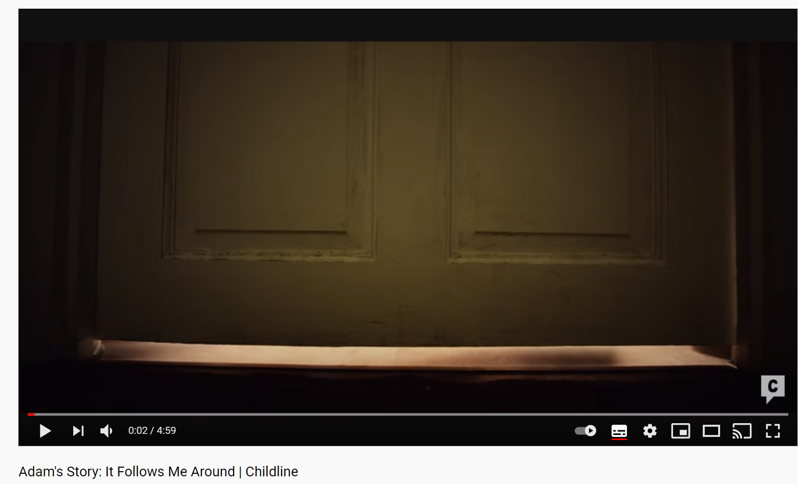
Adam's Story: It Follows Me Around | Childline - YouTube
Notes:
Can choose to show this video – highlights thinking what is behind the behaviour – could it be abuse?
It could be nothing .. But it could be something
We have to consider that abuse could and very much be happening
Child Abuse isn’t always clear cut and is unlikely to be something you know is happening for certain.
That’s why it’s so important for you to be alert to signs that may indicate abuse and know what to do if you spot them.
As School and college staff you are particularly important as you see children and young people on a regular basis, and are in a position to identify concerns early.
This can mean the difference between a child and their family getting the help and support they need which may be able to prevent a situation from escalating.
**note this is an NSPCC advert and it is not to encourage staff to contact the NSPCC –they should speak to the DSL however, it helps to highlight the need to consider what might be behind a child's words/actions**

Slide 66
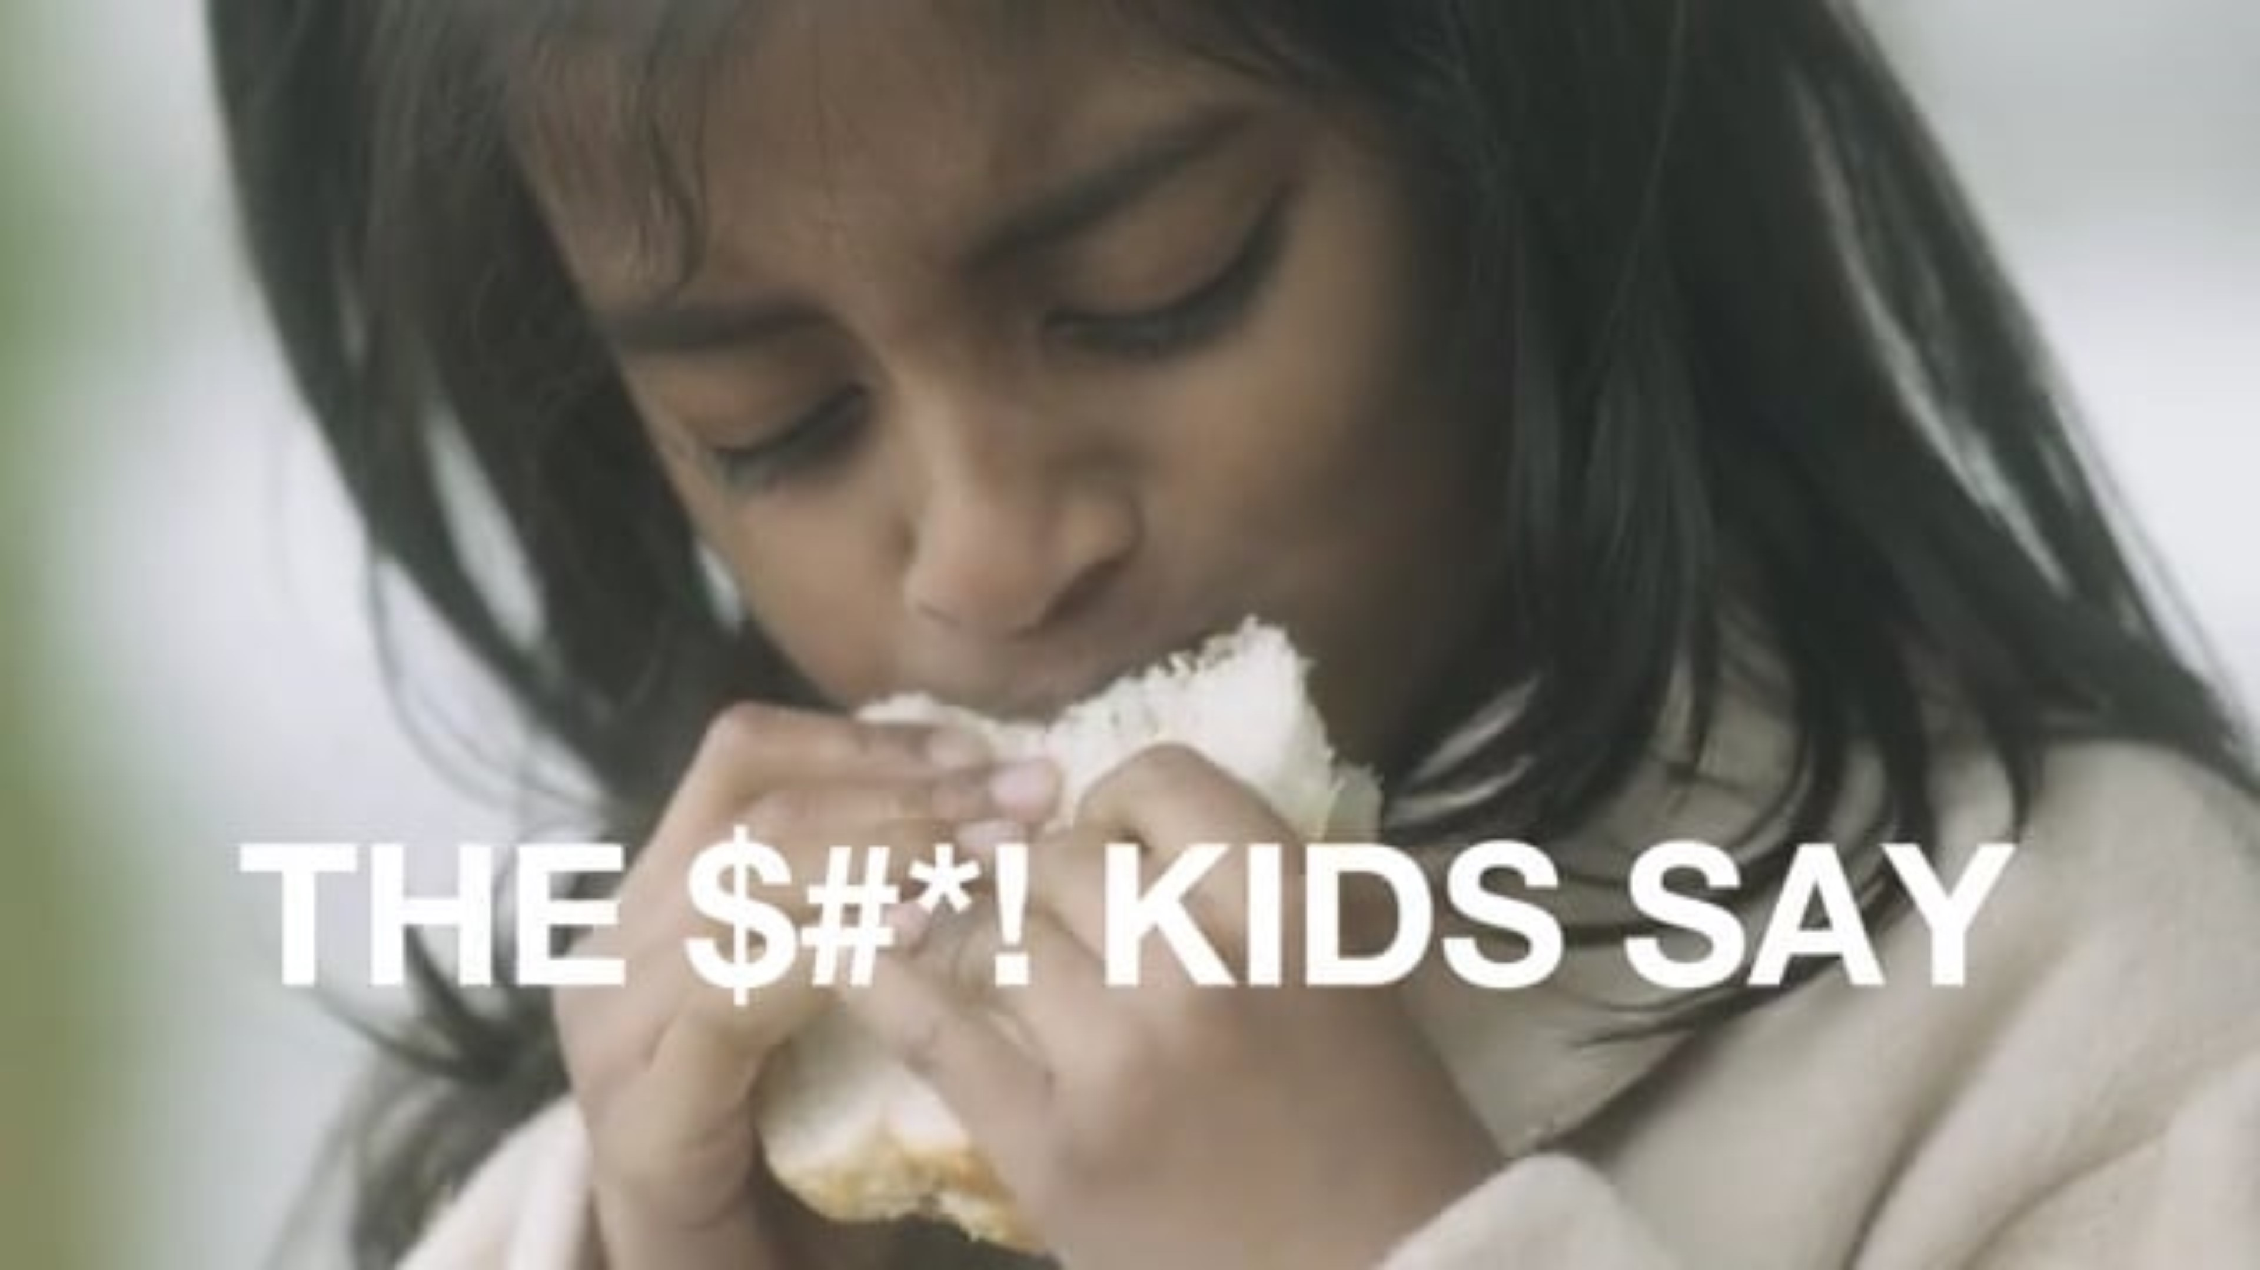
Notes:
Short NSPCC video to highlight listening to children is important and acting on it (sharing with your DSL/LA) is vital to protect children.
https://www.youtube.com/watch?v=dYnLzSUQc6U&feature=youtu.be
Choose either video to get message across or choose any of your own.

Slide 67
What do you do to keep yourself safe as a professional?
Notes:
You can ask staff to answer before showing next slide to see if they know the policies for this and ideas on how they keep themselves safe.

Slide 68
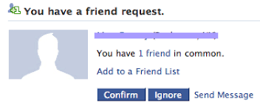
Professional Conduct
Safeguarding also includes keeping yourself, as a professional, safe
Ensure that you are familiar with, and abide by, your code of conduct and any behaviour management policies
If you make a mistake then report this yourself as soon as possible
Take care online, particularly on social media. Do not accept friend requests from children or parents. Maintain your professional boundaries.
Be mindful that what you post could be seen by vulnerable children/parents and be misinterpreted
Notes:
Check your security settings are appropriate and do not post anything confidential, or that could be misinterpreted. Do not post negative comments about your school or school community online.
Know your Acceptable Use Policy – can you use your camera or post to social media when on school site? Keep yourself safe.

Slide 69
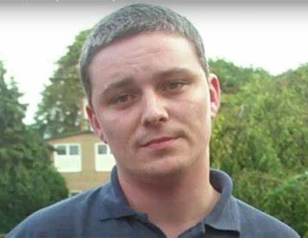

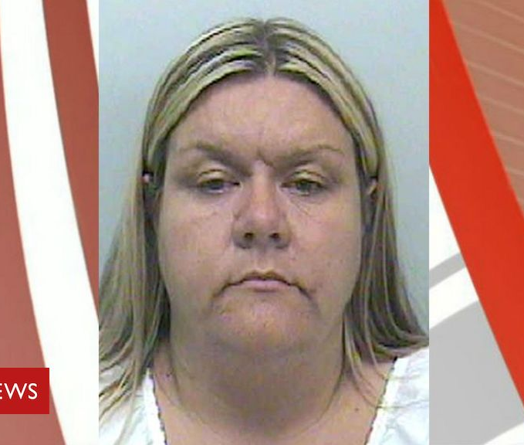
Local Authority Designated Officer
Every Local Authority has a designated team/officer that deals specifically with allegations made against members of the children’s workforce, whether they are staff or volunteers.
Allegations against members of the children’s workforce, in a paid or volunteering capacity, must be taken seriously
Any concerns you have about a colleagues’ conduct must be reported - tell your Head Teacher. If your concern is about your head teacher you should contact the Chair of Governors
Notes:
Where is your whistleblowing policy?
Where is information about the LADO?
Ian Huntley, William Vahey, Vanessa Williams – All worked in schools/Early years setting and convicted for causing serious harm (sexual and violent to children). Reviews found that colleagues had concerns however, hadn’t felt able to challenge or known how to whistle blow. These offenders had established themselves as ‘popular’ members of staff or stereotypes of women etc had stopped people believing they may harm children

Slide 70
What does it mean to work in a position of trust and a notifiable profession?
Make sure you know the policy for dealing with allegations made against staff or volunteers who work with children. Know your obligations if someone brings an allegation to you about a colleague or you witness a colleague cause harm to a child.
If you remain concerned you should follow the whistleblowing policy and can contact the LADO directly
If you break the law or get in trouble with the police especially if it is in relation to harming, or being at risk of harming, children then your employer will be informed and this will be also referred to the LADO by the police and your employer. If you do break the law - make sure you tell your employer first.
If Children Services become involved to safeguard the children this could meet the threshold to also be reported to the LADO. (Not in every case)
If your own children are made subject to a child protection plan – you must inform your employer
Notes:
If your own child/ren are made the subject of child protection plan then it will have to be considered whether this has an impact on your ability to safeguard children in your care at work. If you can not safeguard your own children are you able to safeguard those in your care??

Slide 71

Key Points to take away
Recognise the signs – be curious about the child’s experiences.
Respond - let the child know they have been heard, and understood
Report to Safeguarding Lead – do not delay
Record – Know and follow your safeguarding policy and procedure

Slide 72
Any Questions?

Slide 73
Key Contacts
Early Help and Prevention
strongerfamilieshub@hillingdon.gov.uk / 01895 556006
Nicole Diamond
Deputy LADO
ndiamond@hillingdon.gov.uk
Amandeep Tamber
Education Safeguarding and Wellbeing Officer
Atamber@hillingdon.gov.uk M: 07523 804367
Margaret Tomlinson
Interim LADO
MTomlinson@hillingdon.gov.uk
Fiona Gibbs
Prevent Lead and Stronger Communities Manager
fgibbs@hillingdon.gov.uk
Axis
Axis@hillingdon.gov.uk/ 01895277 177
National Domestic Abuse 24 hour Helpline: 0808 2000 247

Slide 74
Group Exercise
Read through the case study in your groups and consider the following questions:
What is your initial response (thoughts & feelings) about the case study?
What vulnerabilities & risk factors can you identify?
What immediate steps would you take?
If, the young person does not wish to talk to you about their experiences, what would you do to try and overcome this barrier?

Slide 75
Jessica (9) and Leo (5) often look a bit scruffy in school. Their uniform doesn’t appear to be washed often and other children have commented on them being smelly. Recently they have started being late to school more often. A few times Jessica (5) has walked to school on her own and said that everyone at home was still asleep. Mum presents as a bit flustered, but she does appear caring and despite everything the children present as happy and sociable.
Notes:
Think about:
Neglect is usually determined by the persistent signs and indicators, even if mother is caring and children are happy. This still needs to be addressed and support offered to mum.

Slide 76
Jameela (9) is fairly new to your school having moved around a lot. She is quiet but appears to have withdrawn even more over the past few days. She has built up a good relationship and today she tells you that last night her stepdad hit her on the back and locked her in her bedroom. Jameela begs you not to tell anyone and says if you do she’ll be in more trouble and life will be unbearable.
Notes:
Think about:
How do you let a child know that you have to tell someone? What words would you choose? Would you find this hard?
What should you always do – (reassure child, believe them).
Disclosure of child about their parent – what do you do first? Who do you tell? – When do you tell?
Make the point:
If disclosure is of physical/sexual abuse by a parent - Ensure that staff know to report to DSL immediately and that MASH are called before talking to any parent. If it is the end of the day and waiting to get through to MASH – do not let the child go home until MASH have been spoken with.

Slide 77
Anushka (5) tells you that last night daddy was shouting at mummy and mummy was crying. Anushka goes on to say that she saw mummy on the floor looking hurt but daddy said it was an accident. You know that dad is a well-respected doctor in the community and a school governor.
Notes:
Think about:
Domestic Abuse can affect anyone and be perpetrated by anyone. It does not distinguish between status and class. It must be taken seriously and reported to DSL
Child witnessing abuse - trauma

Slide 78
At school MC often hangs around with younger peers. There has been an allegation that MC has tried to kiss one of these peers and touch them on the bottom. MC has then disclosed that their foster carer has been making them feel uncomfortable. Recently the foster carer has started sitting next to MC when they watch TV, they have placed their hand on MC’s leg near their private parts and also asked MC if they can massage each other. MC has been known to make disclosures previously which have turned out not to be true.
Notes:
Sexual abuse by a professional
Abuse of power
Ask the group to think about the sex of the foster carer and child:
MC could be male or female
Foster carer could be female
Even if disclosures have been made and have been false, it is imperative to still believe the child, respond appropriately and report immediately.

Slide 79
An older young person has been meeting Don (10) at the school gates. He calls him ‘bro’ but from your knowledge Don doesn’t have any brothers. Don came into school today wearing some brand new trainers. You know Don lives with his gran and she has told you Don often won’t tell her where has been after school.
Notes:
Think about:
CSE
CCE
County lines
Signs and indicators

Slide 80
Jamie is an 11-year-old student. He is usually a big joker in class and can be outspoken. He is very intelligent and consistently performs above the average for his age. One day you overhear Jamie saying that he is fed up with all the immigrants than come into the country and taking peoples jobs. He feels the government are too soft. He also mentions wanting to make the world a better place. You notice he has been drawing strange symbols on his work book but you are unsure what they mean.
Notes:
Think about radicalisation. What susceptibility factors does he have.
How would staff feel to challenge these views? Where would you start?

Slide 81
Anvir (13) joined the school on a manged move having been excluded from another provision. Anvir is challenging in class and seems angry and frustrated however, won’t engage when people have tried to support him. Anvir is often late for school, when you speak to his grandmother, whom he lives with, she says he is often out late at night and won’t tell her where he has been. Phones aren’t allowed in school and Anvir has had this confiscated on a regular basis. You confiscated Anvir’s phone in lesson today but then saw another phone in his bag.
Notes:
What might be going on?
CCE? County Lines?

Slide 82
A football club hires the school site every Saturday. The school has a lettings agreement in place.
A parent tells you that one of the coaches is shouting aggressively at children and occasionally being physically forceful.
Notes:
•Recognise this is a safeguarding concern (potential emotional/physical harm).
•Take immediate action: consider whether children are safe to continue attending
•Report concern to LADO if allegation relates to an adult working with children
•Inform senior leadership / headteacher
•Contact the organisation and request immediate action and investigation (e.g. suspension of coach)
•Record concern in line with safeguarding procedures
•Review lettings agreement and whether provision should continue
•Ensure clear communication with parents
•Continue to monitor and escalate if further concerns arise

Slide 83
Esmee (13) tells you she thinks she had sex with her boyfriend but she isn’t sure if they actually did or not. She said that she wanted to and he didn’t make her feel pressured.
Notes:
Age of consent?
How would you deal with this? If she wanted to – is it OK?

Slide 84
Maya (12) says she is very worried about current events in Ghaza and doesn’t like what is happening to people there. She watches the news and prays for them.
Notes:
Is this worrying behaviour?
How can you support Maya?

Slide 85
Jasmine (15) tells you that Isla (16) sent a naked image of herself to Tom (16) and Tom has then posted this on a snapchat. Jasmine says she can send you the picture so you can see this yourself.
Notes:
What are the legalities of this scenario?

Slide 86
Robin is 12 years old. She has some cognitive difficulties and struggles a little in class. However, she is very popular and has a large group of friends. One day you notice Robin showing the other girls in the class a picture of her ‘boyfriend’. You make a mental note of it but this is fairly typical behaviour of the girls in your class at the moment so you continue with the lesson. Later that day, as your leaving school, you see Robin kissing a boy at the school gates, she then gets into the car and he drives away.
Notes:
What would you want to find out?
What would you do next?

Slide 87
Christine aged 7 years old reports to you she is very excited as she is missing school in 2 weeks for a special holiday in Malaysia with her mother and sister. Her brother is not going. The parent is vague about the holiday.
Notes:
What information would you need to assess risk?
How might you start a conversation about FG< with the parents?
Who else might you seek information from?
What is your duty of care here? (mandatory reporting duty)

Slide 88
Cain is in the playground and comes to tell you that Alfie has pulled his trousers and pants down and started to thrust his private parts into his and was holding him tight saying. “ is this how you like it bitch?”. Cain is very upset. Alfie has been displaying persistent disruptive behaviour in school for the last year.
Cain is 8 years old and Alfie is 10 years old.
Notes:
How would you support Cain?
How would you support Alfie?
What might you want to know about Alfie (his home life, his internet use, parent's ability to monitor any social media)
What might he be trying to tell you with this behaviour?
Be careful with language – Alfie should never be called a perpetrator – he is a child who has shown harmful sexual behaviour towards another child.

